Slide 1
TxtSpeak
Written Communication
Notes:
Yo, dude! Thz stdy iz Gr8!!!1 The relationship between new technologies and grammar scores in college student

Slide 2
Warm-up
When texting do you use proper grammar?
Does it bother you when people text you using slang, improper grammar, or misspelled words?

Slide 3
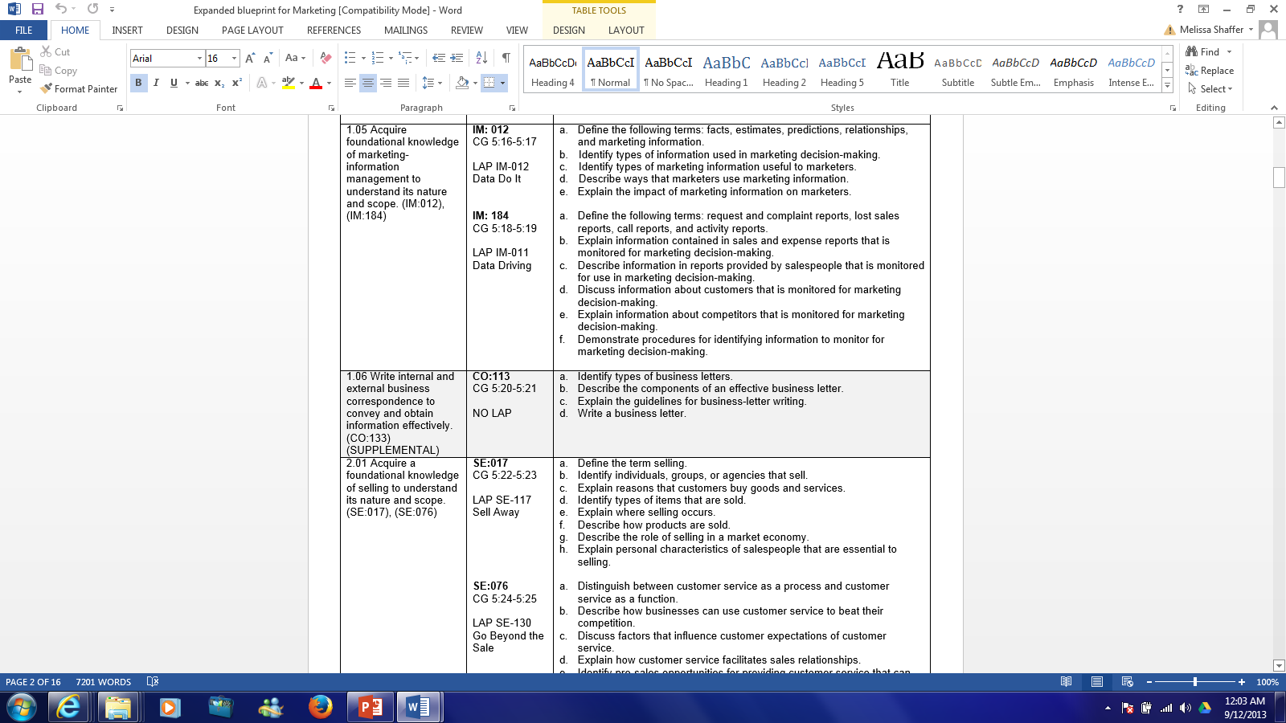
Business Writing

Slide 4
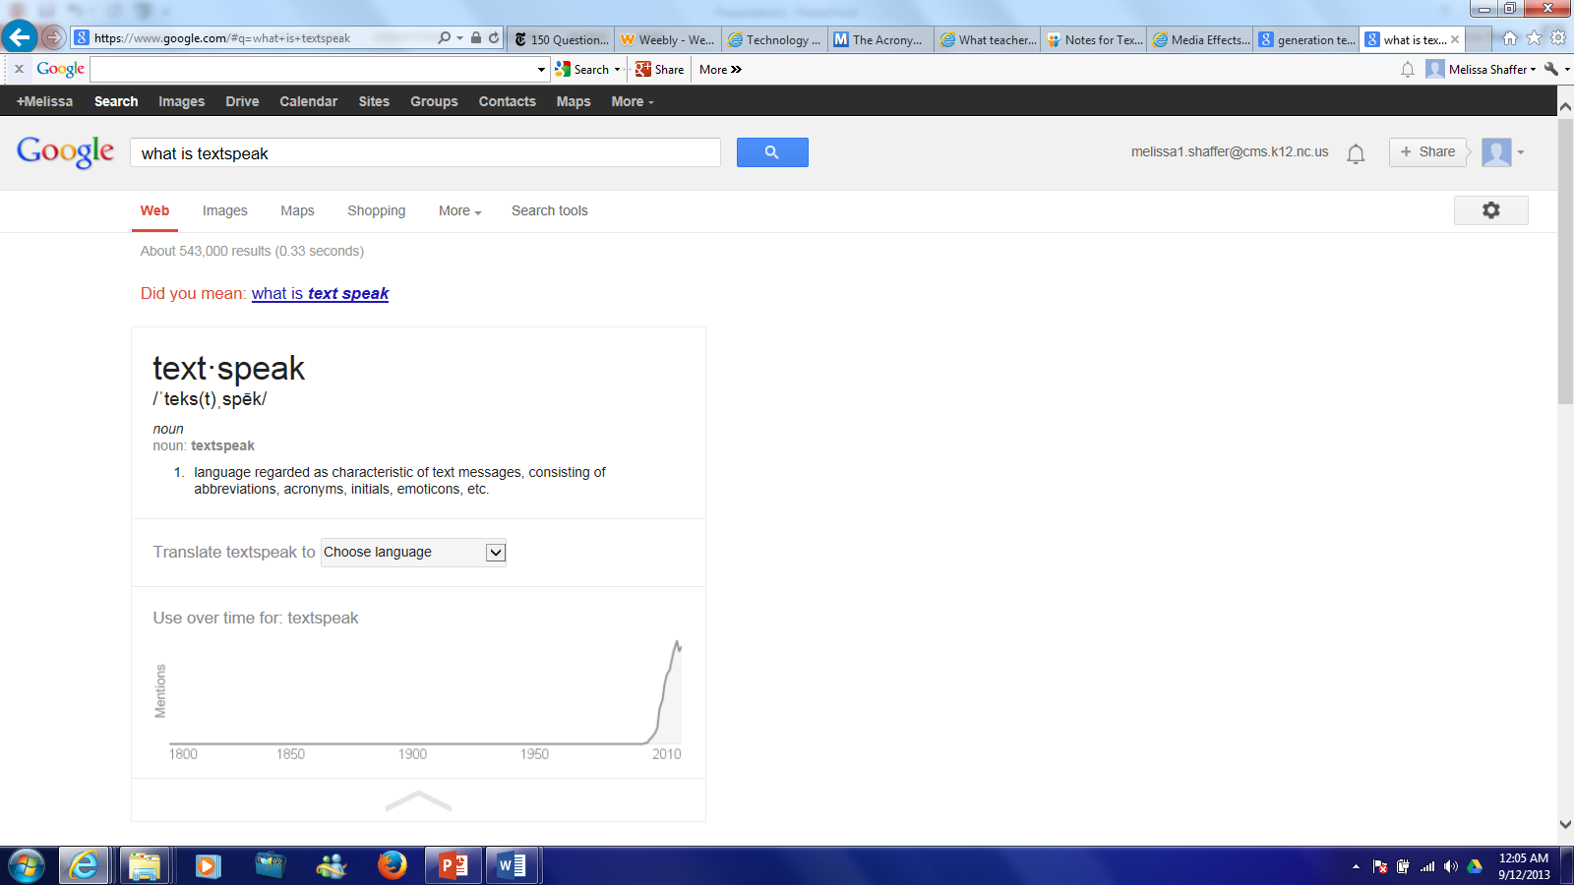


Slide 5
TxtSpk
Where did TextSpeak Start?
  Coined by linguist David Crystal in 2001
Why did it start?
  Texting was difficult due to device being used
  Cell phone companies used to charge by character
  Commonly used in spaces with limited space
    Twitter
    Text Message
    Video Games
  Smaller screen space

Slide 6
TxtSpk
A language where people write like they talk
  Slang terms are used
  Substitute letters, numbers, characters
    I hate you = I h8 u
  A language that is mainly written not spoken due to difficulty & impracticality of words used

Slide 7
TxtSpk
Basic Rules or the “Okays” of Textspeak
  Acceptable to misspell a word: Tho instead of though
  You can substitute out a word for a letter when possible: You = U
  You can create words that can’t be spoken but do have meaning
    P10x = Please Help Me
    Pwn = To completely dominate in some fashion
  Whole words are frowned upon unless used to provide context or not substitute exists
    Example:
      I’m Sorry: Soz, Srry, Sry,
      Apologize: ____________

Slide 8
TxtSpk
TextSpeak is becoming more accepted but does have downside
  Major complaints stem from its lack of nuance
    No use of
      Body language
      Voice inflection
      Pitch
      Tone
      Eye contact
    Typing in all caps looks like your shouting
    Using “Quotations” adds emphasis to a certain word

Slide 9
TextSpeak In Class
Gained notoriety when an English teacher posted this essay online
My smmr hols wr CWOT. B4, we used 2go2 NY
2C my bro, his GF & thr 3 :-@ kids FTF. ILNY, it's a gr8 plc
What does this mean?

Slide 10
TextSpeak
My smmr hols wr CWOT. B4, we used 2go2 NY
2C my bro, his GF & thr 3 :-@ kids FTF. ILNY, it's a gr8 plc
Means
My summer holidays were a complete waste of time. Before, we used to go to New York to see my brother, his girlfriend and their three screaming kids face to face. I love New York. It's a great place.

Slide 11
TxtSpk
Most controversy with TextSpeak stems from the following
  Writing can lack context and meanings can be misconstrued
  TxtSpk doesn’t follow any laws of grammar & uses words not found in dictionaries
  Quicker to write, longer to read
  People are starting to name their children in TextSpeak
    Y = I
    K = C
      Alex-Zander
      Cam’ron
      Emma-Lee
      Ozhkah
      Jasyn
      Mylyssa

Slide 12
Men v. Women Texting Traits
Women's messages tend to be "longer"
Women used more "complex structure" and grammar
Men's messages tend to comprise "one-sentence", "one-clause" or "one-thought" constructions
More greetings and words of parting were observed in women's messages
Women had messages with emotional and practical (e.g. arranging a meeting) content unlike men, who mostly used SMS language for practical content only.
Women and the younger users (across gender) tend to use more shortened forms and emoticons than men
While women observed conventional rules more than men, the difference is marginal. This involves the use of correct spelling, punctuation, capitalization, etc.

Slide 13
TextSpeak in Advertising
The less words an Advertisement uses is good because
  Cheaper
  Catchier
  Less Crowded
Ads that target teens are starting to use TextSpeak
Eat Right 4 Your Type

Slide 14

Notes:
http://online.wsj.com/article/SB120719487786785755.html

Slide 15
Cingular Commercial
https://www.youtube.com/watch?v=4nIUcRJX9-o

Slide 16
Pro-Side
TextSpeak or SMS Language is used only about 20% of the time
  Words are not as abbreviated as they are portrayed
  Abbreviating has been in use for a long time and therefore is not a new concept
  Both children & adults use SMS language, so if adults are not displaying the same mistakes then blaming the language isn’t completely fair
  Students do not use TextSpeak in written works with great frequency
  A pre-requisite of SMS language is to be able to spell correctly in the first place; therefore, not an indicator of low literacy

Slide 17
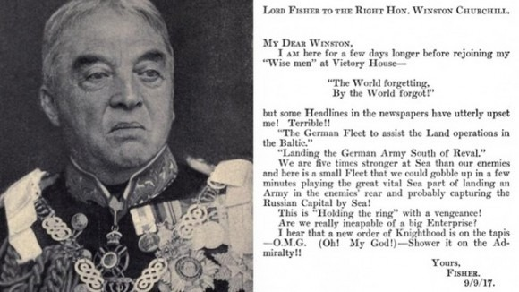
1917 Note to Winston Churchill

Slide 18
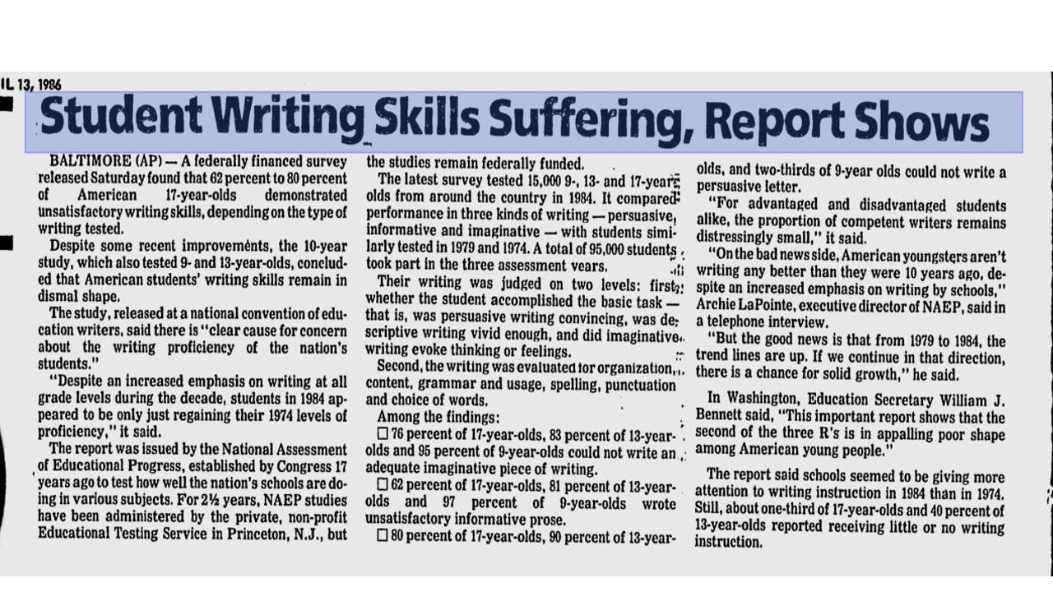
1986 Article About Student Writing

Slide 19
Con Side
TextSpeak causes Ambiguity amongst our language
  LOL
    Laugh Out Loud
    Little Old Lady
    Lots of Love
  Undermines English language
  Younger viewers may begin to misinterpret words as correctly spelled; thus, increasing their likelihood for poor spelling
  Emoticons are irritating & essentially lazy behavior

Slide 20
Assignment
Go to www.melissa1shaffer.weebly.com
TextSpeak Page
Answer the Prompt
  Do you think SMS Language is affecting writing skills in our society
  Three reasons supporting your stance
  Respond to two other posts

Slide 21
Complaint Letters
Marketing

Slide 22
Complaint Letter Facts
People talk about their consumer problems
For every bad experience a consumer has they tell 9 or more people about it
The most common customer complaints deal with
      New & used car sales
      Home improvements
      Auto repairs

Slide 23
Why Complain?
Consumers have the right to complain
Consumers have the responsibility to complain
Complaints make companies better
  An opportunity to correct problems
  Retain satisfied customers
  Avoid similar problems in the future

Slide 24

Keys to a Successful Complaint
Effective complaint letters get results, those expressing anger don’t!
Be pleasant but firm in tone
Be reasonable, not threatening
Notes:
Keep in mind that most errors are unintentional, and realize that most businesses and organizations want to address and clear up complaints quickly in order to have satisfied customers or members.
Be brief. Keep your letter to one page, and write short paragraphs, rather than long ones.
Be honest and straightforward, and include sufficient detail to back up your claim and to show that you have thoroughly researched the subject. However, omit irrelevant details. Keep your letter concise and professional.
Maintain a firm but respectful tone, and avoid aggressive, accusing language.
Send only photocopies of receipts and other documents, and retain all originals. Keep a copy of the letter for your records.

Slide 25
Keys to a Successful Complaint
Get Organized
  Define your problem
  Determine what you think is a fair solution
  Gather all relevant information
    Receipts
    Warranties
    Contracts
    Cancelled checks
    Repair orders

Slide 26
Complaint Letters
Complaint letters are personal business letters
Same rules of formatting apply
  Margins
  Spacing
  Return address
  Recipient address
  Open punctuation

Slide 27
Sample Complaint Letter
2”
10220 Adrey Kell Road
Charlotte, NC
September 12, 2013
QS
Mr. James Bigshot
The Great Start
1234 Green Street
Canton, MI 48188
DS
Dear Mr. Bigshot
DS
PARAGRAPH #1
DS
PARAGRAPH #2
DS
PARAGRAPH #3
DS
Sincerely
QS
Ms. Shaffer
DS
Attachment

Slide 28
Complaint Letters
First paragraph - give some indication of the purpose of the letter
  Recently I was shopping in your pet store and slipped on a banana peel dropped by one of the monkeys you have for sale
  I have been a customer of Shear Madness for three years. Yesterday I received a haircut at your establishment and am not satisfied with my new look.
Notes:
Start out with a positive about the product
State the problem very specifically

Slide 29
Complaint Letters
Second paragraph - give details of the problem or problems you had with the product or service
  When I opened the box, I found that all of the pieces were broken.
  Many friends have commented that my new haircut makes me look like Moe from the Three Stooges
Notes:
Tell them exactly what you expect to do about the problem --- Be Realistic

Slide 30
Complaint Letters
Third paragraph - request specific compensation and end on a positive note
  Please respond to my complaints and refund my purchase price of $39.99
  Please contact me to make an appointment for a new haircut with a different stylist.
Notes:
Enclose identifying materials
Close by stating your confidence in their company’s desire to make it right

Slide 31
Keys to a Successful Complaint
All paragraphs should contain at least three sentences.
Type the letter whenever possible
Keep the letter brief (1 page or less)
Don’t write in an effort to get “Free Stuff”
Keep copies

Slide 32
Your Time To Shine
Complaint Letter Activity
  Select a Product
  Select a Problem
  Select a Solution
Compose a complaint letter based off your selections
  It should effectively communicate your complaint
  Be formatted correctly
  PROOFREAD!
  Attach your selections to your letter

Slide 33
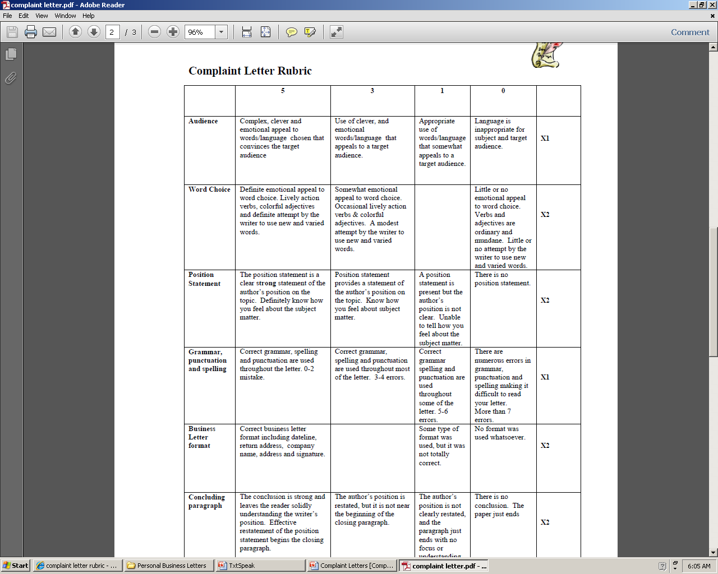
Rubric

