Slide 1
Promotion
4.01:
Acquire a foundational knowledge of promotion
to understand its nature & scope

Slide 2
Monday
4.01
Acquire a foundational knowledge of promotion to understand its nature and scope.
Objective C : Explain the types of promotion

Slide 3
4.01 Part C
What is the intent of Public Relations for a company?
Provide a service for the company by giving the public and the media a better understanding of how the company works
Designed to put a positive spin on company actions
What did you think of the guest speaker?

Slide 5
Monday’s Objective
Define the following terms: promotional mix, advertising, personal selling, publicity and sales promotion.
Identify the elements of the promotional mix.
Categorize examples of promotions according to the elements of the promotional mix.
Describe the importance of the promotional mix.
Identify factors affecting the promotional mix.
Describe how the product being sold affects the promotional mix.
Explain how the product's market affects the promotional mix.
Discuss how the distribution system affects the promotional mix.
Explain how the product's company affects the promotional mix.

Slide 6
Promotional Mix
Promotional Mix:
Personal selling
Advertising
Direct Marketing
Publicity
Sales promotion
Designed to increase brand recognition, raises product awareness, and communicates product benefits.

Slide 7
Promotional Mix: Advertising
Personal Selling: Requires direct personal contact with the customer.
Very costly
Takes place after other promotional activities occur
Advertising – Form of Nonpersonal promotion
Magazines
Newspapers
Television
Website
Buses
Product Placement
Engages in one-way communication

Slide 8
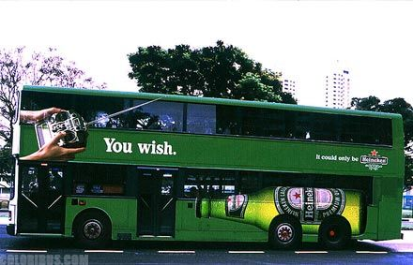
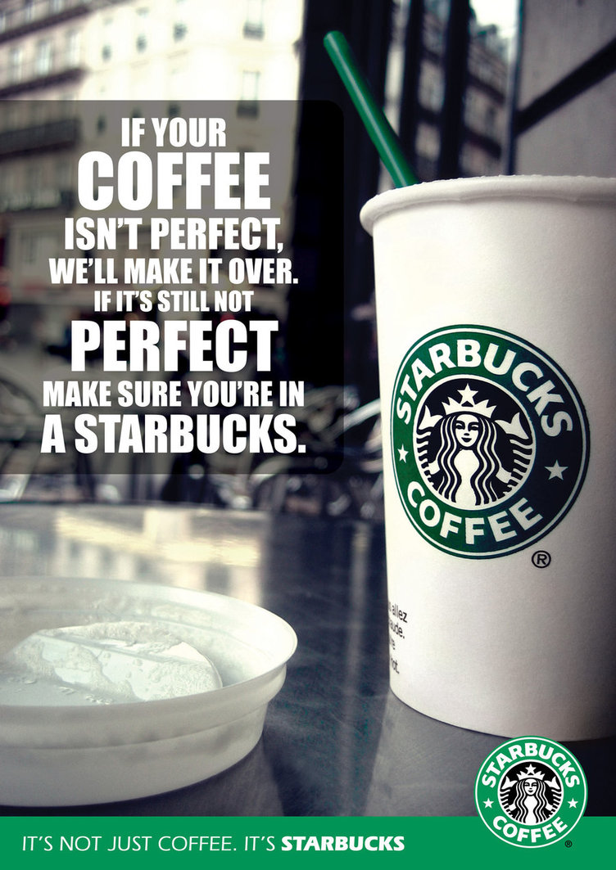
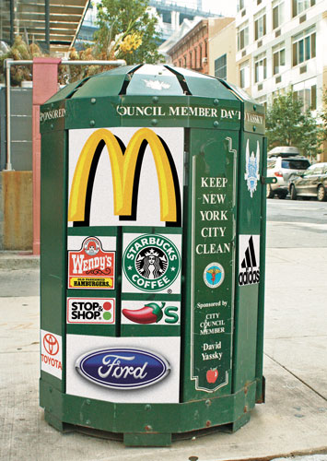
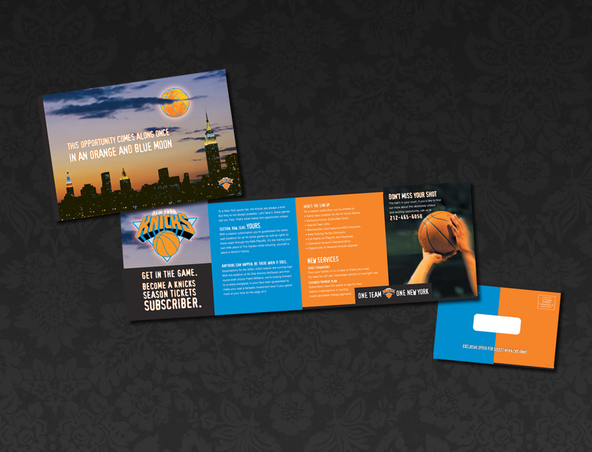
Ad Examples

Slide 9
Promotional Mix: Direct Marketing
Direct Marketing: A type of advertising directed to a targeted group of prospects and customers rather than to a mass audience.
In general physical marketing materials are used (except email lists)
Printed or Direct Mail
Email
Seeks out a response from the customer (Makes it measurable)
Coupon
Special Delivery
Incentive to respond

Slide 10
Catalog & Flyer

Slide 11
Direct Marketing: Coupon

Slide 12
Direct Marketing Works

Slide 13
Promotional Mix: Public Relations
Public Relations (PR) activities enable an organization to influence a target audience.
News Releases
Publicity: Bringing information to the public
Main purpose is to develop a positive perception
Negative publicity can severely damage a company
Example of Bad Publicity:
Firestone tire – Ford trucks rolling over
I-Phones – Incredibly large phone bills, poor service
Toyota – Brakes that don’t work

Slide 14
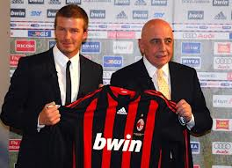
Public Relations Methods
Favorable news release
Appearance on a TV talk show
Feature article
Press conference
Internet newsgroup, bulletin board, or web site
Mention of charitable activities in print or broadcast media

Slide 15
Promotional Mix: Review
Promotional Mix: A combination of strategies and a cost-effective allocation of resources
Most companies use several different approaches
Strategies used should compliment each other
National Advertising v. Local promotions
Mass v. Targeted Promotions

Slide 16
Promotional Mix
Sales Promotion: Represents all marketing activities used to promote sales outside of personal selling, advertising, and PR.
Increase sales
Acquire customers
Create a positive business or corporate image

Slide 17
Sales Promotions v. Advertising
Advertising positions a product or service so that it looks better to a consumer compared to its competition
Sales Promotions include a variety of strategies designed to offer purchasers an extra incentive to buy.
Why use sales promotions?
To increase sales in a short time.
To introduce a new product on the market

Slide 18
Sales Promotions
Sales promotions are Incentives that encourage customers to buy products or services
Broken down into Trade Promotions & Consumer Promotions
Trade promotions are sales promotion activities designed to get support for a product from a manufacturer, wholesaler, & retailer.
Trade promotions focus on businesses selling to other businesses
A lot of money is spent on promoting your product to other businesses versus the actually consumer

