Slide 1
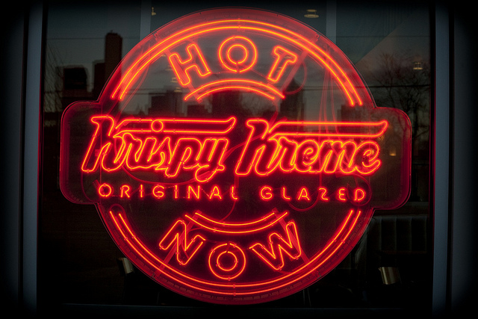
Jackson Wright and Brett Carlson

Slide 2
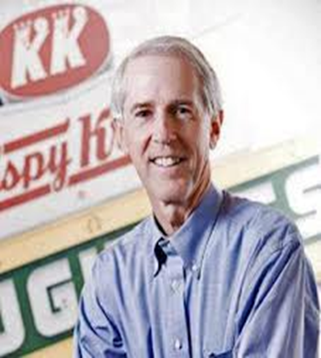
History
Founded by Vernon Rudolph in 1937 in Winston-Salem, NC
Grown steadily over time into an international corporate franchise
Current CEO is Jim Morgan

Slide 3
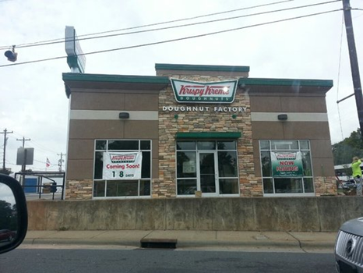
Location
The location for this project is Charlotte, NC
We chose Charlotte because it is the closest highly populated city to our headquarters. We specifically chose the Cotswold location because it is fairly new and has a great market surrounding it.
Charlotte has approximately 775,000 residents
Charlotte is filled with highly educated individuals who make enough money to spend on leisure activities

Slide 4
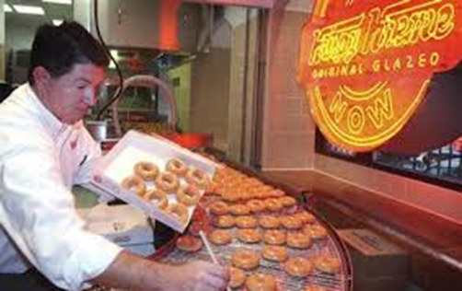
Philosophy
Mission: “To touch and enhance lives through the joy that is Krispy Kreme.”
Target Market: male work professionals and young families
Promotions: Krispy Kreme’s philosophy for promoting is utilizing what they like to call “word-of-mouth-marketing”

Slide 5
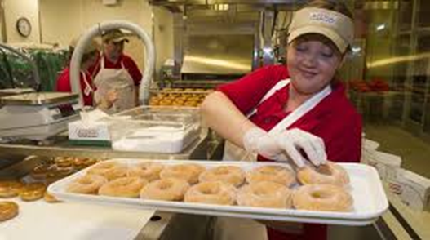
Research
Primary: Surveyed over 100 members of our target market and interviewed 5 employees and the CEO Jim Morgan of Krispy Kreme (Please see pages 29 and 30 for copies of the questions)
Secondary: Pulled from business journals, business reports, previously done surveys, and customer reviews

Slide 6
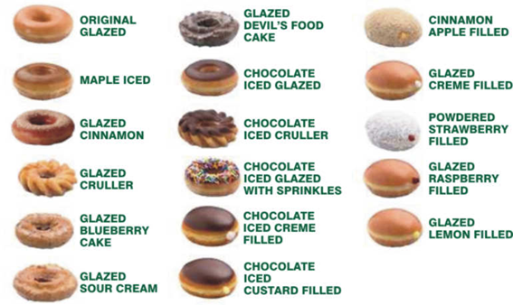
Analyzed Data
Collected and analyzed all the data (please look at pages 31 and 32 for answers to the questions)
We noticed that a high amount of people had problems with our coffee, promotions, doughnut selection, and store availability

Slide 7
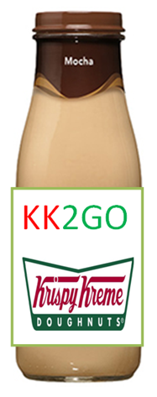
Project
Launch new flavors of doughnuts and coffee
Doughnuts: fat free, grape, strawberry, cherry, apple, peppermint, pumpkin, eggnog, gingerbread, and sweet potato
Coffee: add more espressos and standard coffees in flavors: chocolate, vanilla, caramel, strawberry, pumpkin, peppermint, gingerbread, and eggnog
We will update our coffee machines and beans
KK2GO: refrigerated glass bottles of coffee
Promotions: Introduce new slogan “Served hot and fresh since 1937,” more advertisements in magazines and online, and further our development of promotions on social media
Store availability: We must raise capital to introduce more stores and in order to do that we will attempt to increase sales with this project

Slide 8
Timeline
Event | Day due
Contract coffee and flavoring companies | July 1, 2014
Buy new coffee machines and train employees | July 20, 2014
Introduce new slogan and begin promotions on our social media sites and on Google AdWords | August 1, 2014
Introduce new fruit flavored and low calorie doughnuts | August 5, 2014
Introduce new coffee flavors and KK2GO | August 15, 2014
Publish Advertisement in SI magazine and other magazines | September 4, 2014 weekly issue
Publish advertisement on online websites | September 10-25, 2014
Introduce/ promote fall themed doughnuts and coffee | October 1, 2014-November 27, 2014
Introduce winter themed doughnuts and coffee | November 28, 2014-January 5,2015
End project at Cotswold location and collect and analyze all data | January 10, 2015
Determine if solutions were beneficial and determine if it should be used worldwide | March 1, 2015

Slide 9
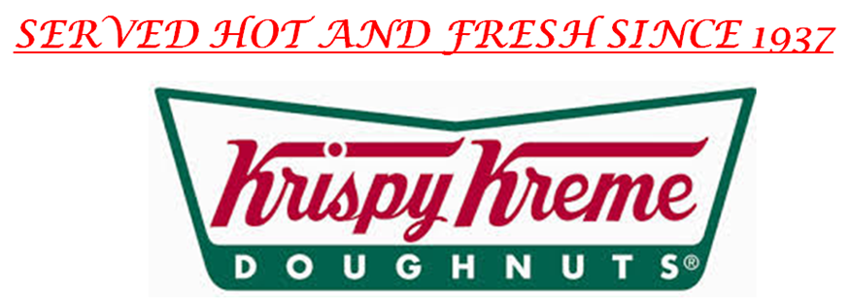
Budget
Total Budget: $401,298
Promotions: $208,000
Merchandise: $44,000
Machines and Flavorings:$9,298
Launch Slogan: $30,000

Slide 10
Goals
Increase store availability by gaining capital from sales
Increase consumer awareness of our promotions
Create a slogan that goes well with our image
Use many of these ideas across the country in all of our other locations
“To touch and enhance lives through the joy that is Krispy Kreme”

