Slide 1
Warm-up / Agenda
David wants to know more about the benefits of his new laptop. What about the laptop does he want to know?
What is the warranty?
What is it?
Where Is it sold?
How much does it cost?
What’s in it for him?

Slide 2
Announcements
Tests grades were updated
2 tests went missing from this class period.
Missing a lot of career assignments
Blanks will turn to zeros by Friday
Print progress reports on Friday (class not school)

Slide 3
Agenda
Feature & Benefit Worksheet
Shark Tank Example
Sales pitch presentations
Limited, Routine, Extensive Decision Making & Emotional v. Rational Buying Motive

Slide 4
Warm-up / Agenda
David wants to know more about the benefits of his new laptop. What about the laptop does he want to know?
What is the warranty?
What is it?
Where Is it sold?
How much does it cost?
What’s in it for him?

Slide 5
Feature v. Benefit

Slide 6
Feature: What it is. Facts about product
Benefit: Why do I care?
Explain features so that the customer sees the value.

Slide 7
Types of Features & benefits
Obvious
Customer needs little explanation because they already know the advantages
Good to point out as reinforcement
Hidden
Advantages that can’t be seen or understood without the salesperson
Exclusive
Advantages that only that product can provide
Selling advantage over competition
iPod + Nike Commercial
Ford Focus
http://global.samsungtomorrow.com/?p=31772
http://abc.go.com/shows/shark-tank/episode-guide/season-05/507-180cup-better-life-kymera-tree-t-pee

Slide 8
Finding features
Ways to Find Product Features
Construction & Materials of Product
Appearance & Style
Unique Features
Durability
Product Uses
Service & Warranty

Slide 9
Sample feature-benefit chart
Product | Features (What are they?) | Benefits (What do they mean?)
Computer | Variety of models | You will be able to select different components to build a system that meets your specific needs
 | Monitor size | Large monitors that come with these computers enable you to see the entire page. Gives a clear understanding of how the document looks
 | Memory | These models can be loaded with sufficient memory so your computer can handle any program
 | Print capability | Handle all your printing needs in your home or office

Slide 10
Features & Benefits
Introduction to selling

Slide 11
Product Features
A feature is a physical characteristic or quality of a product.
It is something the customer can touch, feel, smell, see, or measure
It helps describe the product.
A feature answers the question, “What is it?”
Ex: color, style, size

Slide 12
Product Benefits
A benefit is the personal satisfaction or advantage that a customer wants from a product.
It is how the feature helps a particular buyer
For customers, it answers the questions:
How will I benefit?
What’s in it for me?

Slide 13
Decision-Making & Buying Motive

Slide 14
Customer Buying Motives
What motivates the customer to buy?
Rational Motive – a conscious, logical reason for a purchase
Product dependability
Monetary Saving
Emotional Motive – feelings such as social approval, recognition, power, love, or prestige
Buy expensive because it makes you look better
Impulse shoppers

Slide 15
Determining which decision-making level it is….
1. Level of consumer involvement
2. Length of time to make decision
3. Cost of good or service
4. Degree of information search
5. Number of alternatives considered
Notes:
Previous experience
Interest
Perceived risk of negative consequences
Situation
Social visibility

Slide 16
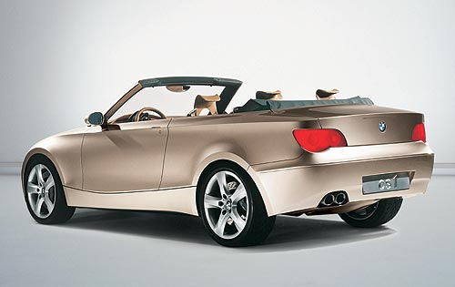
Customer Decision Making
Extensive Decision Making – used when there has been little or no previous experience with the item
High risk items
Very expensive
High value to the customer
High levels of involvement from both customer & salesperson
Consumer will second guess decision
Evaluate a lot of brands
Customer takes longer to decide
Businesses need strong, targeted promotions for these customers

Slide 17
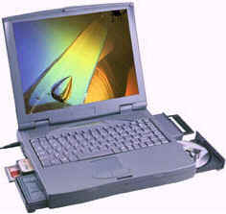
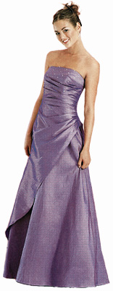
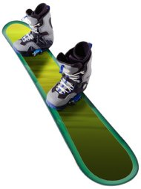
Limited Decision Making – when a person buys goods and services that he or she has purchased before but not regularly
Moderate degree of risk
Few alternative brands that the customer is choosing between
Person needs some information before buying the product

Slide 18
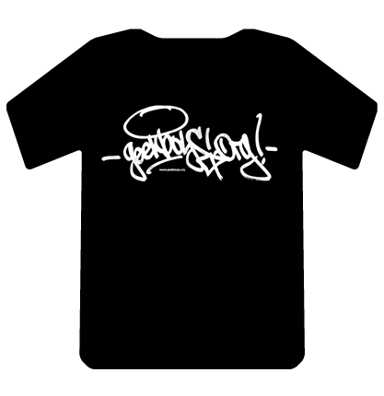
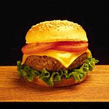
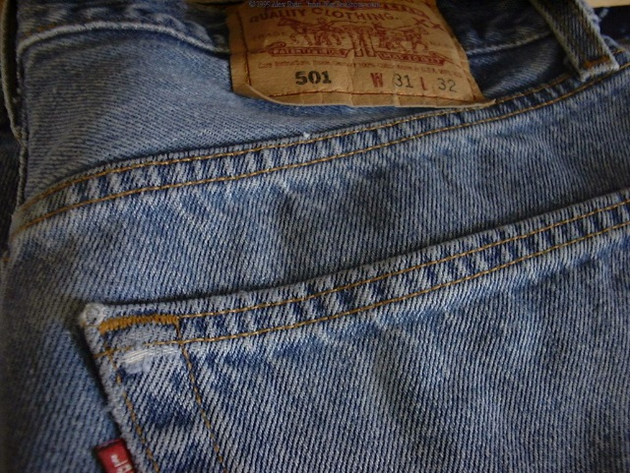
Routine Decision Making – person needs little information about a product
Frequently purchased, low cost goods
High degree of prior experience
Quick decision
Little perceived risk
Buy first, evaluate later
Customers will often buy the same brand
Companies use price promotions to increase sales

Slide 19
Cheat Sheet

Slide 20
Assignment
On the back of your Features/Benefits worksheet complete the following:
Marketing Mix of your product
Price, Place, Promotion, & Product Name
Target Market of product. At least 2 characteristics
What type of decision-making & buying motive would this product have?

Slide 21
Back of sales pitch
What is your products Marketing Mix?
What is the target market of your product?
Limited, Routine, Extensive Decision Making
Example of Each
Your product emotional or rational?

