Slide 1
International Channel Design
Chapter 8.1
International marketing

Slide 2
International Channel Design
Channel of Distribution: the path used to move products from their source to the customer
Logistics: Activities that create an orderly and timely acquisition and transportation of products through the channel of distribution
https://www.youtube.com/watch?v=Vu3o2-3uSKE
What are three things that go into the logistics of a water bottle?

Slide 3
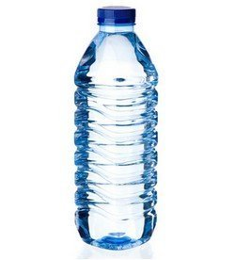
Water Bottle
Involves Everything Pertaining to a product
Packaging materials
Recycled plastics to bottling company
Bottle cap is shipped to same bottling company
The safety seal is shipped to the same bottling company
Labels are shipped from graphics company
All materials are packaged together
The Water itself is shipped to same bottling company
Making sure the water is shipped to all outlets
Time oriented
Location driven
Manufacturer - Distribution center – Retailer/Consumer Outlets

Slide 4
Channel Length
Most products are not sold straight from manufacturer
Most people do not buy their pencils directly from bic
What are you wearing / using right now that you purchased from the manufacturer that made it?
When you purchase an item from a supplier outside of the manufacturer you are using an intermediary
Intermediary is an independent business that assists the flow of goods and services from producer to customers

Slide 5
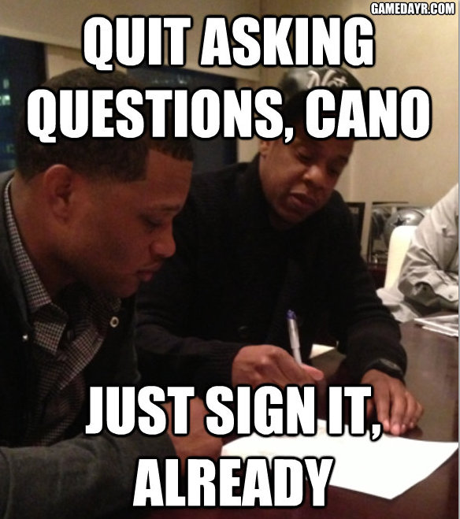
Examples of Intermediaries
Agents & Brokers: They don’t own the products they sell; they just move them
Real Estate
Sports Agents
Example Jay Z & Roc Nation Clients
Robinson Cano
Dez Bryant
Ndamukong Suh
Kevin Durant

Slide 6
Examples of Intermediaries
Wholesalers: A business selling goods in relatively large quantities to buyers(retailers) other than the ultimate consumers.
Sell products in the Industrial Market
https://www.youtube.com/watch?v=IGk2ityMI4M (3:18)

Slide 7
Intermediaries
Retailers: A business or person that sells goods to the consumer as opposed to a wholesaler or supplier.
Fruit Snack for someone who can name 1 of the top 5 retailers in the world?

Slide 8
Trends in Channel Management
General Trend in Channel Management is Shorter distribution channels
Less intermediaries involved
Cheaper for Walmart to buy directly from Hanes or General Mills than from Associated Grocers
Shortest channel is a direct channel
A long channel is indirect & uses intermediaries
Consumer goods typically use a longer distribution channel (Indirec)

Slide 9
Role of Intermediaries
Breaking bulk shipment into smaller quantities
Provide information to other channel members
Storage of products
Transportation of products
Provide financing
Promote products

Slide 10
How Channel Management Leads to a Competitive Advantage
Facilitate Just-In-Time Inventory (JIT) Systems
Products arrive just as they are needed
Computerized Inventory & Point-of-Sale Systems provide constant inventory feedback to warehouses & suppliers
Allows businesses to cutback on how much inventory they store
Manufacturers & Shippers focus on distributing product at the right time & at the right location
https://www.youtube.com/watch?v=Li5P2Zdifgg
Lower Cost: Being more efficient
Speed up distribution: Customer gets product into customer hands quicker
Support expansion into new markets Use existing or new distribution channel

Slide 11
International Channel Design
When entering a new market; International Marketers can either:
Work within an existing channel of distribution
Companies will often redesign the distribution channel to increase efficiency
Establish a new channel of distribution
High risk strategy
Arrange for the importing of inventory
Develop warehouses
Develop delivery systems
Choose retail locations
Hire & train employees
Need to develop new relationships with suppliers

Slide 12
Total Cost Concept
Total Cost Concept: all costs must be taken into consideration when designing a channel of distribution
Added shipping costs
Transportation time must also be considered
Insurance
Storage
Inventory Losses
Coca-Cola could produce its product in America and ship it overseas but because it is mainly made up of water; it is much cheaper to manufacture in foreign markets.
What happens to the cost of a product when distribution costs are high?

Slide 13
Channel Relationships
All distribution systems seek to achieve the lowest cost possible.
Can result in disintermediation: The removal of channel members to save costs
http://www.youtube.com/watch?v=LACYuGoP4IE
Examples of results due to disintermediation

Slide 14
Channel Power
Some channel members have more power than others
Channel captain – takes the leadership role in organizing a distribution system
Examples are Coca-Cola & Walmart
Gain power through their ability to reward or punish channel members and through their knowledge of their product-market
As channel captain; Coca-Cola can discontinue its relationship with certain vendors if they are not successful or reward vendors that are

Slide 15
Finding International Partners
There are a number of ways for international marketers to find partners.
Government sources from commerce departments
Trade show contacts
Internet
Current distribution members (Distributors, Sales Employees, Customers)
Export Management Companies (EMC’s) specialize in helping businesses distribute products.
Act as an agent or broker
Agents typically don’t own the product but make commission off the sale of it
Agents can be like “flip that house” https://www.youtube.com/watch?v=VFuwWGIldS8

Slide 16
Children’s Story Assignment

Slide 17
8.1 Activity: Auto Dealer
Research an automobile manufacturer who has opened up a manufacturing plant in a foreign country in order to lower total cost of distribution to that country
http://www.kia.com/#/about/
http://corporate.honda.com/america/facilities.aspx
https://www.bmwusfactory.com/
http://corporate.ford.com/our-company/operations-worldwide
http://media.gm.com/autoshows/Chevrolet_Centennial/2010/public/intl/en/chevrolet/news.detail.html/content/Pages/news/intl/en/2011/centennial/03_01_the_first_100_years.html

