Slide 1
Exporting & Logistics
International Marketing

Slide 2
True or False: 8.1 Review
A long channel of distribution will have multiple intermediaries
Logistics takes into account multiple aspects of channel management including order processing & transportation of products
Companies use Just-In-Time Inventory as a way of stockpiling merchandise so that they always have ample amount of merchandise on-hand
A channel captain is always the manufacturer of a product
The total cost concept is the same thing as production costs.
Agents & brokers are common examples of Export Management Companies (EMCs)
Companies can gain a competitive advantage via their distribution channel

Slide 3
Why April is a Bummer
4/4, 1968 Martin Luther King Jr. Assassinated
4/5, 1994 Kurt Cobain suicide
4/14, 1865 President Lincoln Shot
4/15, 1912 Titanic Sinks
4/15, 2013 Boston Marathon Bombing
4/16, 2007 Virginia Tech Shooting
4/19, 1995 Oklahoma City Bombing
4/19 1993 Waco, Texas
4/20 Facts
1836 Wisconsin became a state
1889 Adolf Hitler’s Birthday
1912 Fenway Park opened in Boston
1916 Wrigley Field opened in Chicago
1920 Tornado kills 219 people in Alabama & Mississippi
1999 Columbine High School Massacre; 13 killed & 24 injured
2007 Johnson Space Center Shooting
2010 BP Oil Spill Disaster

Slide 4
April 20th Agenda
7:20 am – 7:45 am Children’s Story

Slide 5
Importing & Exporting
Importing is the receiving of goods
Exporting: The process of shipping a product to another part of the world for trade or sale
Exporting Includes:
  Identification of customers
  Preparing products for shipment
  Arranging documentation
  Clearing customs
  Planning shipping/delivery of products

Slide 6
Direct v. Indirect Exporting
Indirect Exporting: Occurs when a business uses an agent or broker to help find customers & export products
  Useful when a company isn’t fully committed to international marketing
  Can increase the total cost of the sale
Direct Exporting: A company actively controls finding markets and exporting products.

Slide 7
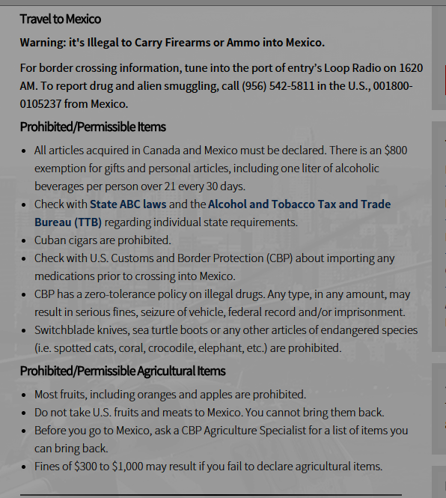
Documentation
When a product enters a foreign market it must clear customs
Customs: Acts as immigration control for products entering the country
  Inspect shipments to insure proper documentation
  Collect customs fees
  Insure restricted products do not enter
    E.g., dangerous items, embargoed products, fake products, endangered species products
Customs Broker: An intermediary that helps products move through customs.
  Licensed by U.S. Department of Treasury
  May also work with Dept. of Agriculture, Environmental Protection Agency, or Food & Drug Administration

Slide 8
Documentation
Bill of lading: Issued by carrier (transporter) to shipper (exporter) acknowledging receipt of goods
  Describes type and quantity of goods
  Describes how goods will be shipped
  Identifies destination
  Great Video on the BL: http://www.youtube.com/watch?v=nmosREOfkXw
Certificate of origin: Document that identifies the country in which exported goods are obtained, produced, or processed
  Helps determine import duties or whether the products may be legally imported depending on country of origin

Slide 9
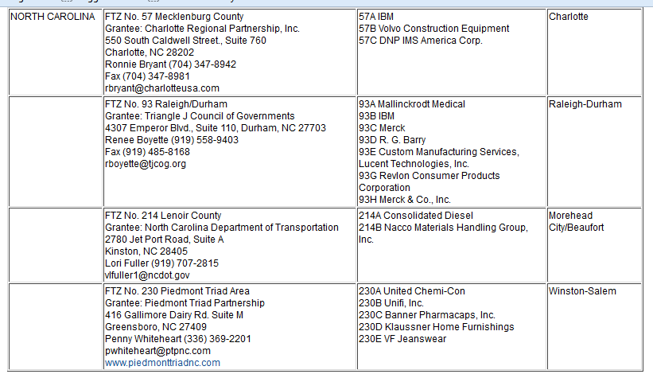
Documentation
Foreign Trade Zone (FTZ): an area designated by a country as a specialized zone where products may be exempt from duties
  Products in FTZ’s may be stored, modified, displayed without paying duties
  Products exported out of FTZ’s no import duties are paid where the FTZ is located

Slide 10
International Logistics
Logistics involve the transportation and storage of products between producer and consumer
Modern technology makes logistics easier than in the past:
  GPS allows ships to avoid bad weather
  Easy to track individual shipments

Slide 11
Total Cost Concept
Shipping by water or land is generally cheaper in terms of transportation costs
Total Costs May Not Be:
    Greater chances for spoilage, loss, or obsolescence
    Warehousing and insurance costs may be higher
    Air freight enhances security, limits shipping time, assures faster delivery
  Marketers need to look at the end cost when determining which mode of transportation to use

Slide 12
Logistics & Freight Terms
Free on board (FOB)—determines where the shipper pays the transportation costs
FOB destination—seller pays shipping costs to the buyer’s delivery point
FOB Origin—buyer pays shipping costs from the seller’s departure point
May include cost, insurance, and freight (CIF)

Slide 13
Transportation Modes
Water transportation
  Within a continent—utilize rivers and lakes
  Cargo containers used for overseas shipping
    About 90% of the worlds trade is shipped via containers
  Good for bulk items such as grain or minerals
  Half of all U.S. imports arrive via cargo container—over 9 million containers yearly
Air cargo
  Containerized jumbo jets can carry over 90 tons
  Costs are higher than other transportation
  Fast delivery avoids need for warehousing
  Less opportunity for theft

Slide 14
Transportation Modes cont.
Land transportation
  Two main modes: rail and truck
  Rail typically used for bulk products
  Usually require land connections to air or ferry
  Long-distance land shipments increase chance of loss, damage, delivery uncertainty
Pipelines
  Primarily for energy-related products (oil and natural gas)
  Coal can also be put into a liquid mixture (slurry) and shipped through pilelines

Slide 15
Freight Terms
Intermodal transport involves a combination of transportation modes.
  Fishyback: Containerized shipping between trucks & ships
  Piggyback: Shipping between truck and rail
  Birdyback: Shipping between truck and air cargo

Slide 16
Assignment
Using the textbook or this PowerPoint; create 10 quiz questions over the following concepts:
  Exporting
  Direct or Indirect Exporting
  Customs or Customs Broker
  Bill of Lading or Certificate of Origin
  Free Trade Zones (FTZ)
  Logistics
  Total Cost Concept
  FOB, FOB Destination, FOB Origin, CIF
  Transportation Modes
    Water, Air, Land, & Pipeline
  Intermodal Transport
  Must type out questions & provide correct answer
    Submit through Edmodo

