Slide 1
Billboard Examples
Marketing Ad Campaigns

Slide 3
Eno

Slide 4
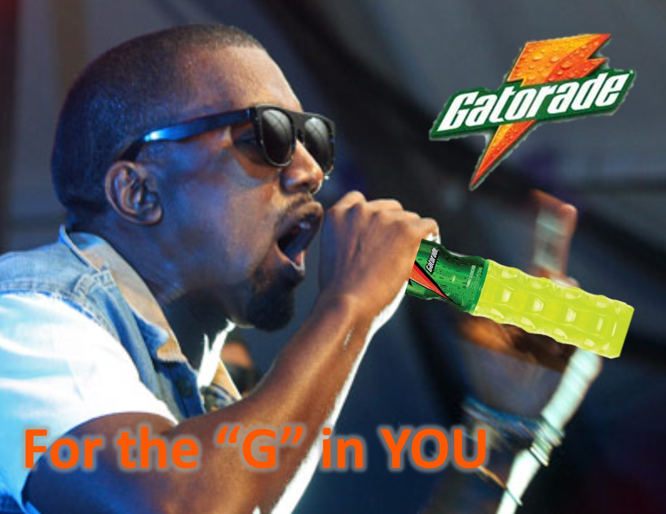
Gatorade

Slide 5
Monster

Slide 6
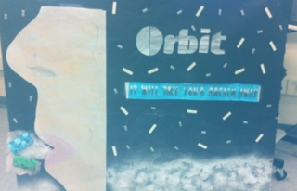
Orbit

Slide 8
Titleist

