Slide 1
Ludacris Soul Headphones
Andrea and Milan

Slide 2
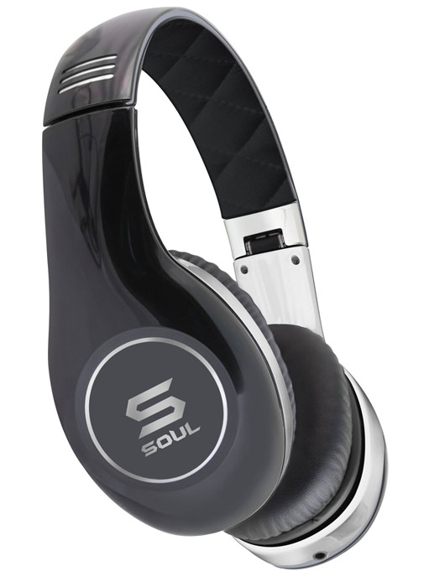
Tangible:
the packaging
wireless,
brand name
emblem: S
good quality
Intangible:
Brand recognition
Warranty
Fast shipping/delivery
Good customer service

Slide 3
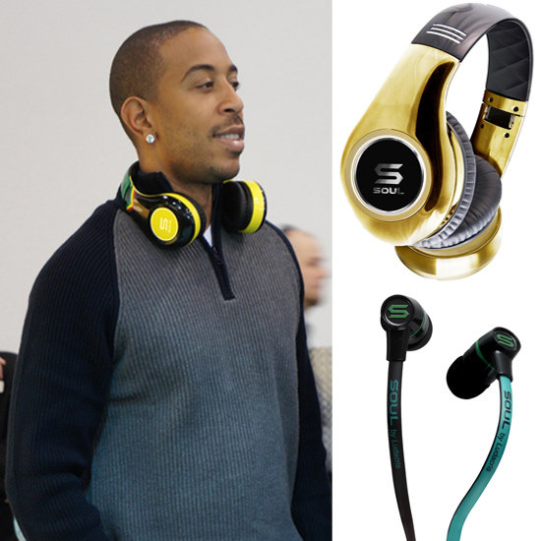
Strategy
Strategy #2: Adapt an existing product for a new market.
We can take it to China, and keep it the same. We chose it because everyone likes good sound quality with their music and they are cheap compared to other companies.

Slide 4
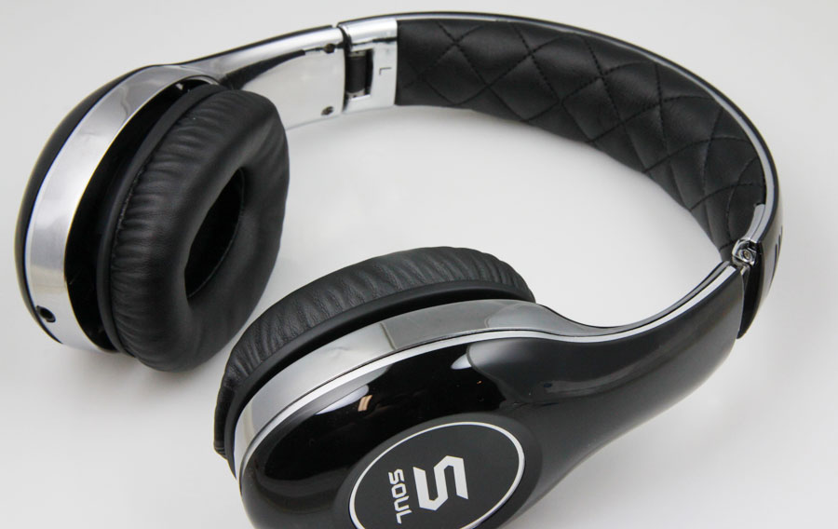
GOOD SOUND QUALITY,
GOOD PRICE.
Positioning Approach: it has better quality than beats for a lower price

Slide 5
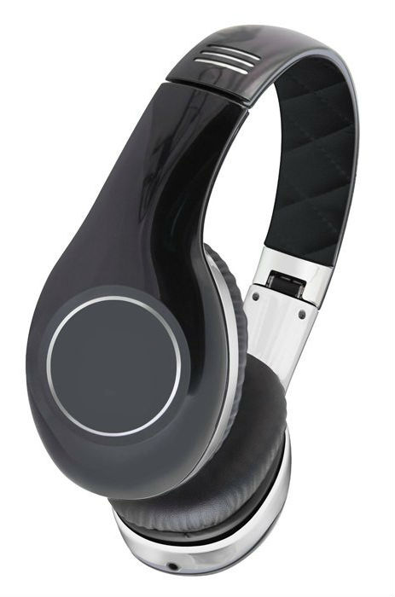
Grey Market Version
The colors of the grey market version are not neutral like the Souls. They come in bright colors like orange, red, blue, and green.
For the grey market6, we would charge $80, unlike the original which are about $120.
M
Milan J’s

Slide 6
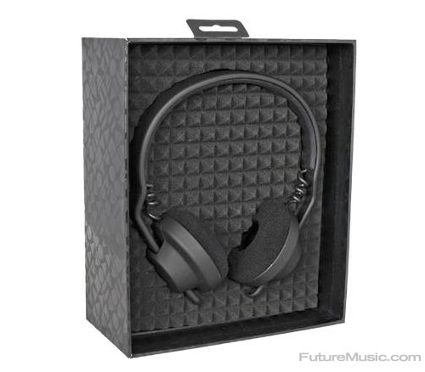
Product Packaging
Family Brand: Soul Electronics
Brand Name: “Soul” by Ludacris
SOUL
Soul Electronics

