Slide 1
Cupcake Central

Slide 2
Target Market #2: Generation X
35 – 50 year old; health conscious home bodies who are working professionals
Enjoy Fruity Flavors over chocolate
Price:
Frugal, Low-Cost is Key
Promotion
Traditional Methods & Social Media

Slide 3
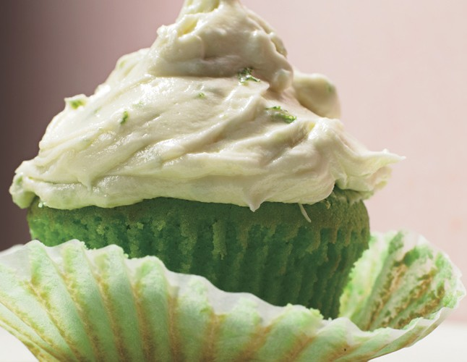
Key Lime Cupcake
CUPCAKES
1 cup all purpose flour
¾ cup self-rising flour
½ cup (1 stick) unsalted butter
1 ¼ cup sugar
2 large eggs
2 ½ tablespoons fresh lime juice
1 tablespoon finely grated lime peel
¼ teaspoon neon-green food coloring
¾ cup buttermilk

Slide 4
Frosting Recipe
1 8-ounce package cream cheese
1 ½ cups powdered sugar
½ cup (1 stick) unsalted butter
1 tablespoon finely grated lime peel
½ teaspoon vanilla extract

Slide 5
Trade Character Slide
Insert Image
Name
Purpose
Slogan
List Boldly
Be catchy

Slide 6
Cost of Goods Sold
$35.22 + $.33/lime
Total: $35.55
Makes 1 Batches
$2.96/each
+$3.89 Cream Cheese
+.33/lime
Total: $39.77
Makes 2 Batches
$1.66/each
Makes 3 Batches $43.99
$1.23 / each
Flour
Self-Rising Flour
2 sticks unsalted butter
Sugar
2 Eggs
Lime Juice
Buttermilk
Vanilla
Cream Cheese
Powdered Sugar
1 Lime
Green Food Coloring

Slide 7
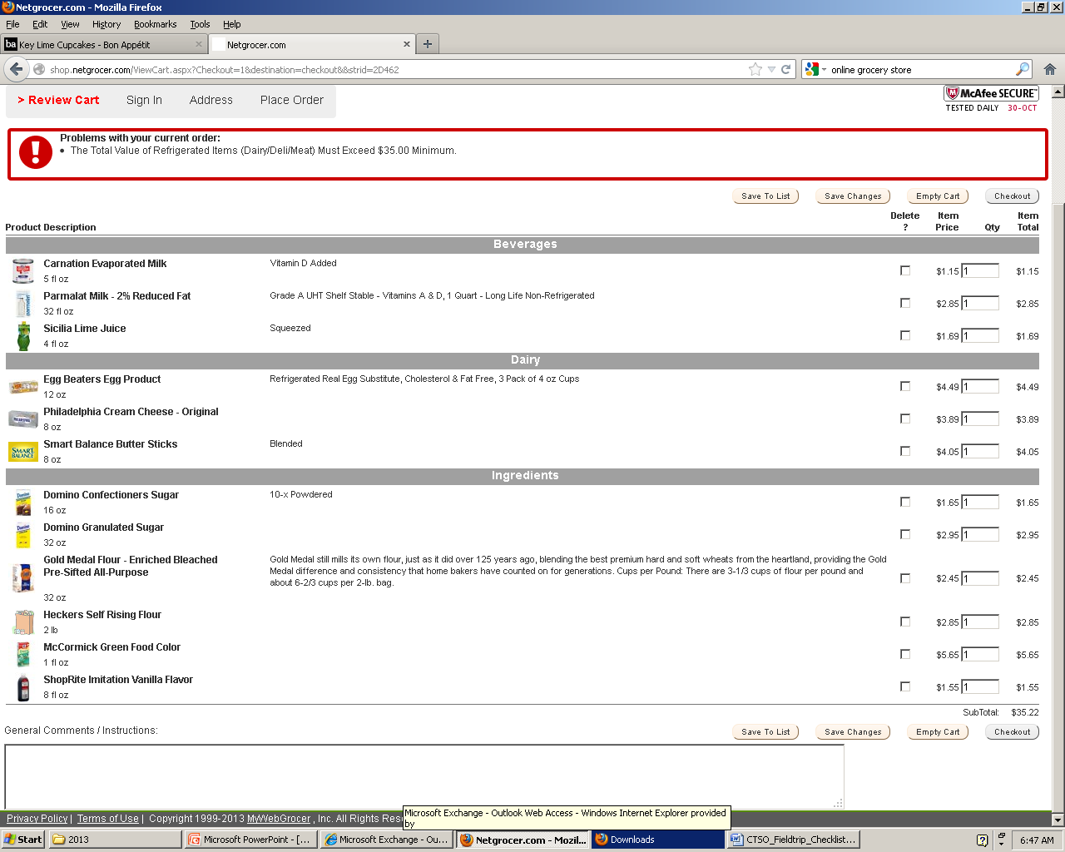

Slide 8
COGS Option 2
Simply list how much you paid for ingredients.
Determine how much you can make from amount purchased
Estimate Cost

Slide 9
Marketing Mix
Promotion
Facebook, Pinterest, & Magazine Ads
Food Network, All You, Women’s World, & First Magazine
Create brochures for distribution at events we attend; downloadable @ www.cupcakecentral.com
Price:
$1.99 / each
$5.99 / 6 cupcakes
$9.99 / 12 cupcakes
Bakeries:
$2.99 - $4.99/ea
$32.00 - $49.99 / 12 Dozen
Place:
Craft Shows
Corporate Events
Community Events
Online Orders
($10.00 S&H)
Product:
Key Lime Cupcakes
Also available in cherry, lemon, strawberry, orange cream, & raspberry

Slide 10
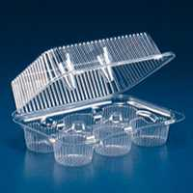
Packaging / Label
Understand the 2 functions you are incorporating

Slide 11
Label
Find a product that uses a brand label.
A brand label will give the brand name, trademark, or logo. Brand labels typically just promote the product, not inform. Example would be Chiquita Banana stickers.
Find a product that uses a descriptive label.
A descriptive label gives information about the product’s use, construction, care, performance, & other features. An example would be a food label that gives product illustration, weight statements, ingredients, dating & storage information, product guarantees, etc..
Find a product that uses a grade label.
A grade label states the quality of a product. An example would be canned fruit being labeled A, B, or C

