Slide 1
JV Men’s Soccer
Eric Ahn & Jack Morton

Slide 2
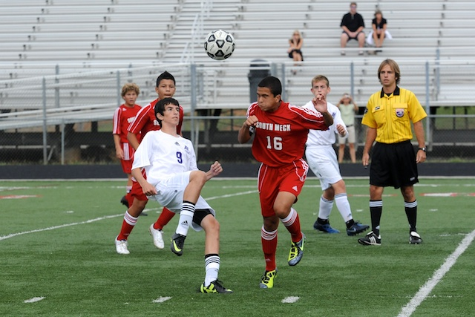
Group
I chose this group because we feel like they deserve more support from AK students. Although, the JV game is not intense as the varsity game, it is entertaining.

Slide 3
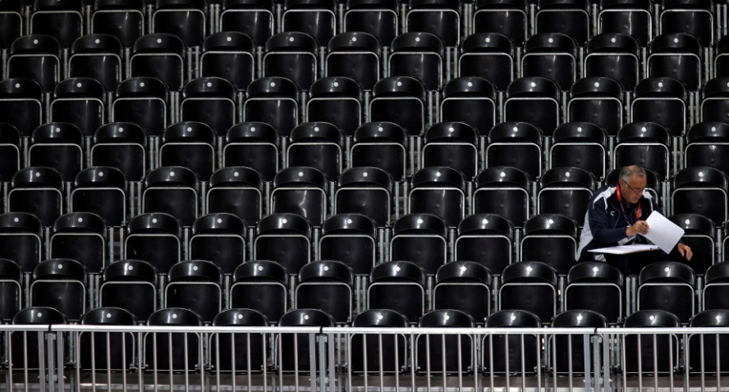
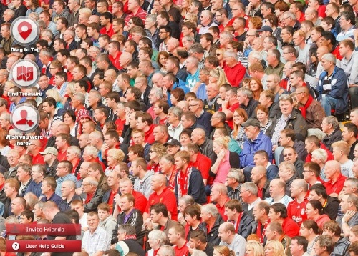
Define Problem
The problem is that there are not many supporters at JV men’s soccer games. The purpose of our research is to find the reason why people do not attend JV men’s soccer games, and find ways to increase the attendance for JV men’s soccer.

Slide 4
Survey

Slide 5
Overall Respones
Males: 87% Female: 13%
Juniors : 33% Seniors: 67%
How much are you interested in JV Boys Soccer on scale 1 to 10 with 10 being the best– The average was 1.13.
67% of people said they don’t go JV Soccer because it is not a varsity event. 33% of people said that they don’t go because soccer is boring.

Slide 6
Observation Made on 9/18
A majority of the people at the game were either sophomores or freshman. There were very minimal, if any, upperclassmen. Also a very large group were parents of the kids who were playing. There were a couple of administrators that were standing near the entrance watching the game.

Slide 7
JV Men's Soccer Record for 2013

Slide 8
Secondary Source
http://www.cmsathleticzone.com/schedule/team_instance/408645?subseason=107559
This website has the record of JV soccer games.
Most of JV soccer games’ scores were blowouts. Although they defeated the other team, the game is not very captivating when one team is dominating. For soccer, the games are intense when both teams have even chances of winning the game. AK Men’s soccer might have higher attendance if the games become more intense.

Slide 9
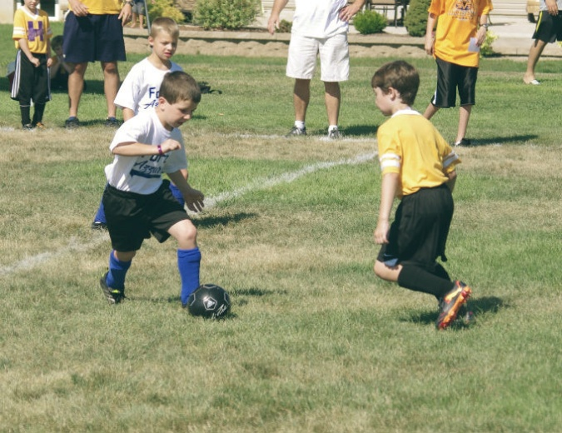
Analyze Data
JV men’s soccer games have less attendance than Varsity men’s soccer games. There were two main reasons why people didn’t go to JV soccer games. First, 33% of people said that soccer is a boring sport. Second, 67% of people said that JV games is not important like varsity games.

Slide 10
Solutions
Get Austin Baker, Ardrey Kell President, to promote our games on the morning announcements.
Give students incentives to go to the games, such as raffles and lotteries.
Bring back old JV players that are now famous, such as Guissepe Gentile. He is the starting forward on UNCC soccer team, and he is projected to go first round the year he enters the draft.

