Slide 1
Economic Environment
4.2: International Marketing

Slide 2
Warm UP
Pick up pre-test
  Grade your answers as you go along
Turn in purple sheets for rough draft of 3B
  Final draft was due over the weekend
Part IV A rough draft is due Tuesday
Scanned version of the paper is online
  Follow rubrics
  Look at sample paper for examples

Slide 3
Activity #1
Pushups
Partner Up
For every 5 push ups you do you get a piece of candy
  Partner counts
  You have to tell me your results

Slide 4
What is a Political Economy?
A political economy refers to the idea that international business is influenced by economic & political/legal environments of countries
  United States is a mixed economy where the government sets rules & regulations on both production and trade.
  America also has a Republic
    A republic is a country where the democratic process elects representatives to govern the country
    Examples of republics include USA, France, Haiti, & South Africa

Slide 5
What is an economic system?
An economic system governs how a country controls production, distribution, & consumption of goods & services.
Three Basic Economic Questions:
  What goods and services should be produced?
  How should goods & services be produced?
  For whom should the goods & services be produced for?

Slide 6
Types of Economic Systems
Four Main Types of Economic Systems Include:
  Market Economy
  Mixed Economies
  Planned Economies
  Traditional Economies
The type of economic system you work in will have a direct impact on how you utilize the 7 Functions of Marketing

Slide 7
Market Economy
In a Market Economy…..
  The free market determines which products are produced
  The free market determines how products are marketed & priced
  Ownership of private property exists
  Entrepreneurship is encouraged
  In a pure market economy there is little to no government interference
  Examples of mixed economies include the United States & Japan

Slide 8
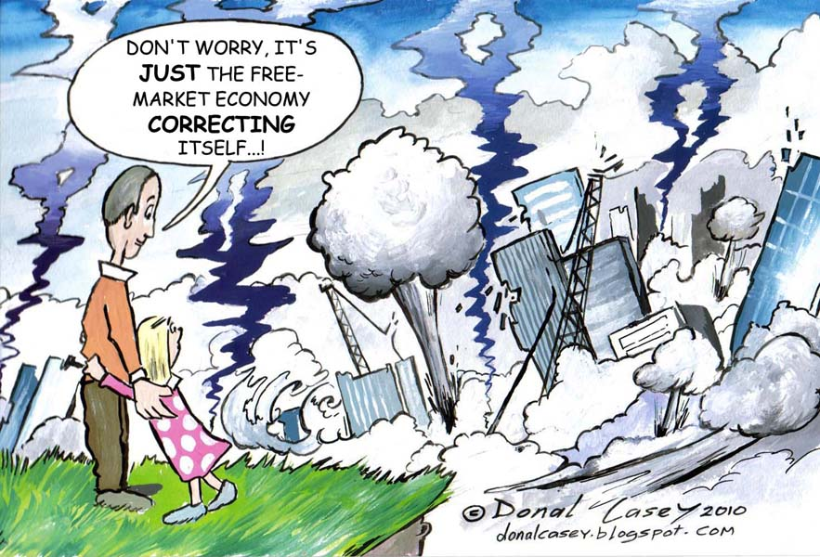
What is this insinuating about a free market?

Slide 9
Mixed Economies
In a mixed economy….
  A market economy is combined with varying levels of government control
  Most developed countries are mixed economies
  In most cases, Government control is used to protect consumers & laborers
  Businesses must compete fairly
  Capitalism & Socialism are strong forms of a mixed economy
  Socialism sets strong rules & regulations to control business practices
  Aims to protect all citizens

Slide 10
Characteristics of Capitalism
Little government interference
Means of production is done by private firms
Goods & Services are distributed according to supply & demand
Pro’s & Con’s will come courtesy of debate
  Creates wealth inequality
    A capitalist believes that inequality encourages innovation
  Profit drives efficient use of resources
  Boom & Bust period
    Great growth & high unemployment can occur

Slide 11
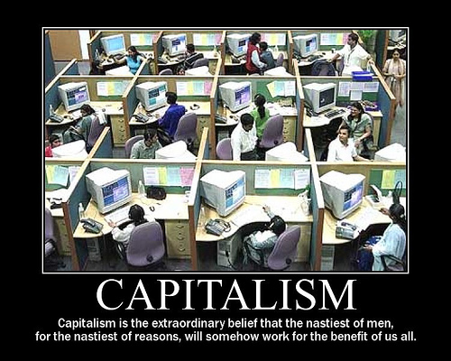
Explain

Slide 12
Socialism
Debate will add detail but concept is……
  Social Equality is the goal
  Free education & healthcare
  Political Equality
    Workers are typically treated fairer
  Taxes are higher
  Citizen debt is higher
  Less entrepreneurship
  Bigger government

Slide 13
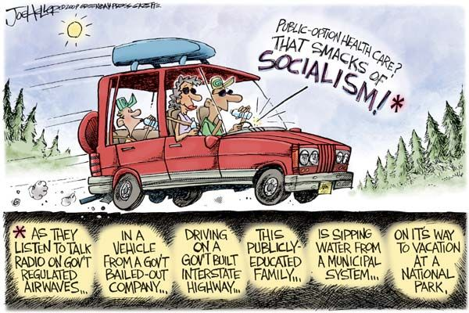
Explain

Slide 14
Planned Economy
In a Planned or Command Economy:
  The government is the central planner in a planned economy
  Government tends to have a dictator in charge
  The government plans the types of products produced
  Determines where products are sold & the prices to charge
  The goal is to not generate a profit but to ensure everyone has equal access to education, employment, & health care
    Corruption often impedes equality
  Citizens are often imprisoned or killed if they go against the government
  Censorship is prominent aided by military and media
  Laziness is often rewarded because they will provide you with food, housing, & a job regardless of how good you are
Examples:
  Russia used to be a communist country
  China still is communist but is transitioning into a more market-based economy
  North Korea, Cube, Laos, & Vietnam are currently communist
Notes:
http://www.pri.org/stories/2013-12-10/can-you-name-five-remaining-communist-countries-world
Opposes communism
https://www.youtube.com/watch?v=3W7sejVY9WU

Slide 15
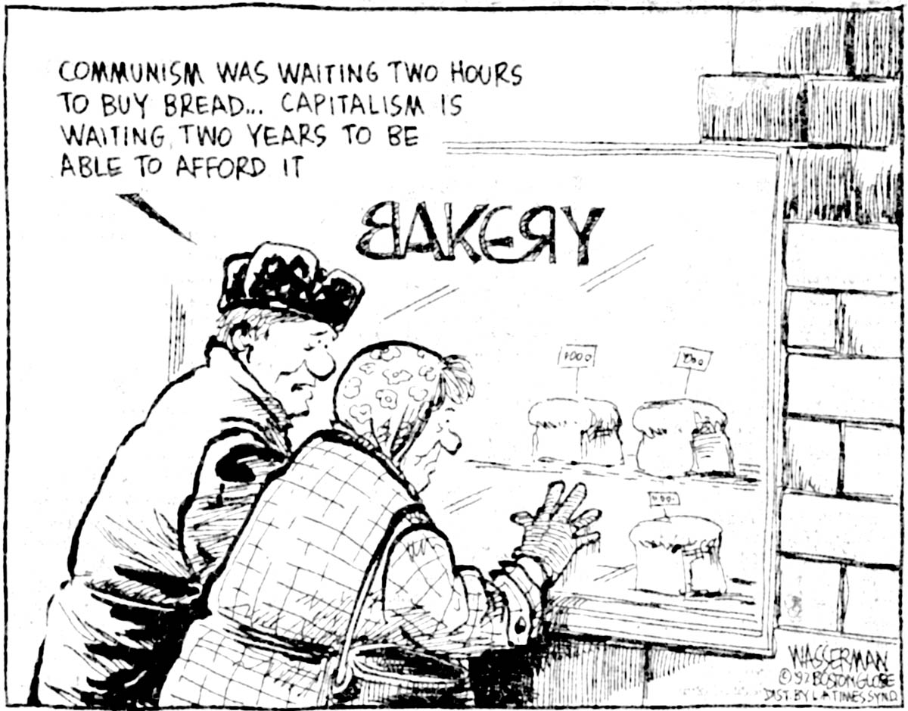
Explain

Slide 16
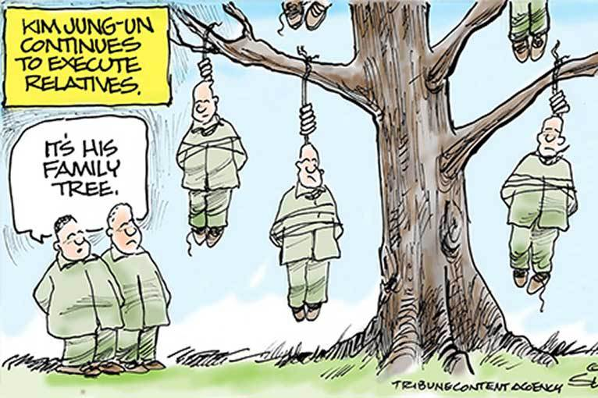
Explain https://www.youtube.com/watch?v=CzGVLYB-tdY
Notes:
https://www.youtube.com/watch?v=yhnaJp89_6A

Slide 17
Traditional Economy
In a traditional economy…..
  Customs, religious beliefs, and historical patterns determine how economic questions are answered
  It is based on agriculture, fishing, hunting, gathering or a combination of these
  Center on family or tribes
  May appear to be living in poverty even though needs are being met
  Common in 3rd World Countries and some developing countries
Examples of Traditional Economies
    The Amish
    Aborigines
    Amazon tribes

Slide 18
Economic systems
Depending on the economic structure in which you work; sales strategies will be developed accordingly
Many companies are cautious about selling to China
  Weak government control over patents and competitive practices allows for Chinese companies to steal product designs and packaging.
  Chinese companies don’t contend with rules & regulations regarding workers safety or the environment

Slide 19
Activity
Monopoly
  http://www.huffingtonpost.com/2014/03/26/new-monopoly-rules_n_5035044.html
Form teams of 4 or 5
Play 25 minutes of capitalism
Play 25 minutes of Socialism
Play 10 minutes of capitalism

Slide 20
Warm up
What are the 4 types of economic systems illustrated in class?
  Market
  Mixed
  Planned
  Traditional
List 1 characteristic of each

Slide 21
Traditional Economy
In a traditional economy…..
  Customs, religious beliefs, and historical patterns determine how economic questions are answered
  It is based on agriculture, fishing, hunting, gathering or a combination of these
  Center on family or tribes
  May appear to be living in poverty even though needs are being met
  Common in 3rd World Countries and some developing countries
Examples of Traditional Economies
    The Amish
    Aborigines
    Amazon tribes

Slide 22
Market Economy
In a Market Economy…..
  The free market determines which products are produced
  The free market determines how products are marketed & priced
  Ownership of private property exists
  Entrepreneurship is encouraged
  In a pure market economy there is little to no government interference

Slide 23
Mixed Economies
In a mixed economy….
  A market economy is combined with varying levels of government control
  Most developed countries are mixed economies
  In most cases, Government control is used to protect consumers & laborers
  Businesses must compete fairly
  Capitalism & Socialism are strong forms of a mixed economy
  Socialism sets strong rules & regulations to control business practices
  Aims to protect all citizens
  Examples of mixed economies include the United States & Japan

Slide 24
Planned Economy
In a Planned or Command Economy:
  The government is the central planner in a planned economy
  Government tends to have a dictator in charge
  The government plans the types of products produced
  Determines where products are sold & the prices to charge
  The goal is to not generate a profit but to ensure everyone has equal access to education, employment, & health care
    Corruption often impedes equality
  Citizens are often imprisoned or killed if they go against the government
  Censorship is prominent aided by military and media
  Laziness is often rewarded because they will provide you with food, housing, & a job regardless of how good you are
Examples:
  Russia used to be a communist country
  China still is communist but is transitioning into a more market-based economy
  North Korea, Cube, Laos, & Vietnam are currently communist
Notes:
http://www.pri.org/stories/2013-12-10/can-you-name-five-remaining-communist-countries-world
Opposes communism
https://www.youtube.com/watch?v=3W7sejVY9WU

Slide 25
Agenda
Part 3B final draft grades are in
  50 points
  Formal
Part 4A Rough Draft was due over break
  Received 2
Economics Paper was due Monday, November 24
  Received 1 group (Colleen’s Group)
  Landon’s paragraph

Slide 26
Step #1 - 3
Complete 4A worksheet
  If you did not turn in your rough draft this is the only way I will edit it
  Due today
Turn in Economics Paper
  Debate will be on Wednesday
Assignment today
  Read p. 89 & 90 on types of political systems
  Illustrate an example of a democracy, republic, One-Party States, & Theocracy
  Draw a political cartoon, comic strip, or create an ad promoting an upcoming election that reflects that type of political system

