Slide 1
The Elements of Culture
International Marketing

Slide 2
Warm-up
In your own words define what you think culture is.
What is the culture of Ballantyne?

Slide 3
Agenda/Announcement
First Quarter Grades
A
B
C
D
F’s
Test poorly
Paper is behind
Did not turn in written portion of case study
You have until 5:00 PM today to turn it in.
Homeroom all week / KT Next
DECA Testing today after school
Sub Wednesday

Slide 4
Objective / Essential Questions
Exemplify culture and how cultural influences affect international marketing
Explain six elements of culture.
Why should international marketers be familiar with the belief system of a culture?
Provide five types of non-verbal communication.

Slide 5
What is Culture?
Video #1: https://www.youtube.com/watch?v=57KW6RO8Rcs&list=PLFE2745C2AE430076
Video #2: https://www.youtube.com/watch?v=NSCFxDKJWwo
What is Culture?
A system of shared beliefs, values, customs, & behaviors that define how a group of people live.
Why do American Companies need to Care about Culture in other countries?

Slide 6
United States Fan Club
The United States has a strong image in many countries
Some countries view Americans positively
European
Asian
Latin American
African
Some countries view Americans negatively
Middle Eastern
Russia
China
Greece
Turkey
Argentina
Germany is declining
Top 20
Countries that
Don’t Dig America
Notes:
http://www.pewresearch.org/fact-tank/2014/07/15/which-countries-dont-like-america-and-which-do/

Slide 7
Fans v. Critics (July 2014)

Slide 8
Enculturation
Cultural learning begins 1st day one begins to learn.
Enculturation - a process that helps people learn about their culture
Early on children learn the sounds & patterns of their family language
Learn favorite foods & drinks
Learn elements of the world around them & how to fit into that world
Language, Belief Systems, Values, Attitudes, Manners, & Customs
Children are introduced to material goods & social institutions
This process helps structure a child’s brain as they adapt to their environment

Slide 9
Examples of Enculturation
In many Western cultures, babies are taken out into world almost as soon as they are born.
In Ghana, mothers spend first weeks alone with their babies.
Christian parents typically have their young children baptized.
In US, most young children recognize McDonalds golden arches
In US, Cheerios are popular finger good for young children
What is another example of enculturation in America?

Slide 10
Context
Humans determine meaning within a cultural context
Context refers to the background or surrounding circumstances of an event
Can be interpreted through the communication process
Determine what is being said based on discussions, gestures, expressions, body language
Countries range from High-Context Cultures to Low-Context Cultures
https://www.youtube.com/watch?v=uMGu89XBcT0
https://www.youtube.com/watch?v=8tIUilYX56E
https://www.youtube.com/watch?v=at7srdUiRfM

Slide 11
High-Context v. Low-Context
High-Context Cultures | Low-Context Cultures
Interpersonal Relationships are important | Personal relationships are less important than getting a task done
Citizens are guided more by emotions & feelings versus Logic or Facts | Decisions are based on Facts
Decisions are made by groups rather than individuals | People value individualism
Communication is more indirect & vague | Communication is concise, direct, & structured
Context is more important than words | Words & their meaning(s) are more important than context
Which is the United States?

Slide 12
High-Context v. Low-Context
High-Context Cultures | Low-Context Cultures
Interpersonal Relationships are important | Personal relationships are less important than getting a task done
Citizens are guided more by emotions & feelings versus Logic or Facts | Decisions are based on Facts
Decisions are made by groups rather than individuals | People value individualism
Communication is more indirect & vague | Communication is concise, direct, & structured
Context is more important than words | Words & their meaning(s) are more important than context
High-Context Countries include: Greece, Japan, China, & France | Examples of Low-Context Countries: The United Kingdom, USA, Germany, & Switzerland

Slide 13
Issues with Context
Problem occur when High-Context Cultures work with Low-Context Cultures
Usually easier for high-context to adjust to low-context
Example: The Statement “I Agree”
Japan: Statement is understood
Switzerland: An actual agreements has occurred

Slide 14
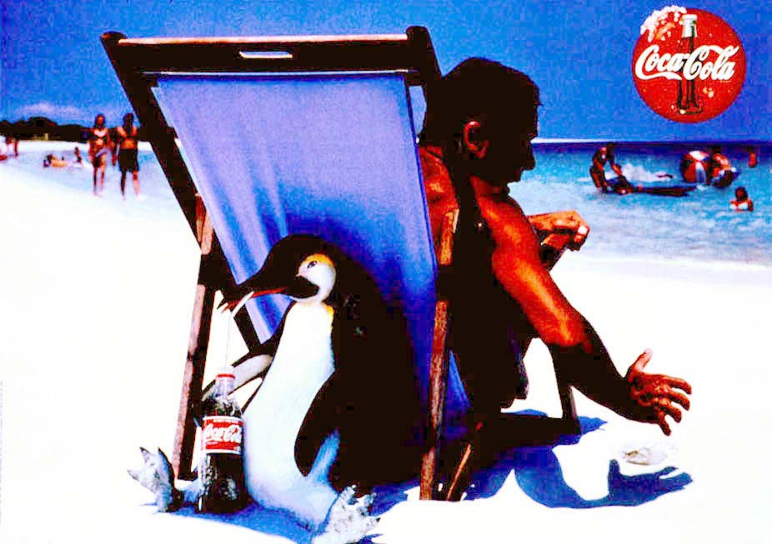
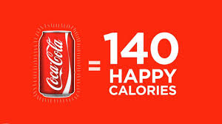
High Context v. Low-Context

Slide 15
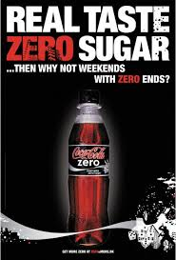
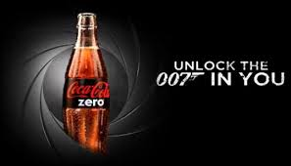
High v. Low

Slide 16
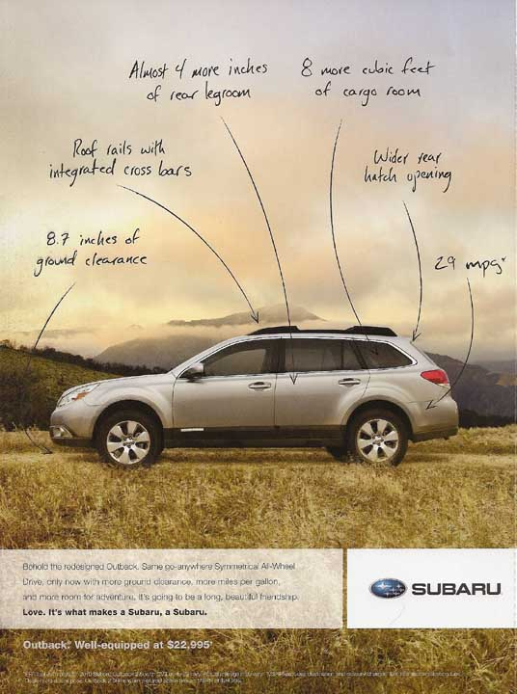

Slide 17
Advertising Differences
High-Context Culture
French Shell Commercial https://www.youtube.com/watch?v=WeR-Cs8245o
French Car Commercial: https://www.youtube.com/watch?v=IUNv3ddb2Ks
Japan https://www.youtube.com/watch?v=Sc59X7xS2ts
What’s so funny? https://www.youtube.com/watch?v=ieEtkTnvBEA
Low-Context Culture
https://www.youtube.com/watch?v=Thv_tOW_wF0
https://www.youtube.com/watch?v=R__EnsSwtVk
Notes:
http://interculturalzone.lokahi-interactive.com/2009/08/15/high-context-v-low-context-cultures-getting-your-message-across-is-not-simply-a-question-of-vocabulary-and-grammar/

Slide 18
Assignment
With your partner, design a high-context cultural advertisement & a low-context cultural advertisement for your company
Advertisement can be a magazine ad, flyer, commercial (video with cell phone or act out)
Label each advertisement high or low
Ads need to be on separate pieces of paper or powerpoint slides
List five examples of Enculturation in America & in your Business Country
Cultural norms of your society & in America
http://www.kwintessential.co.uk/resources/country-profiles.html

Slide 19
Communication
The predominate language of business is English
American companies need to be able to communicate with their partnering country
Collect information
Work with others
Have to rely on others to understand what is going on
Out of respect for your partnering country a basic understanding of language should be acquired
Greetings
Common phrases

Slide 20
Verbal Communication
Verbal communication involves use of words, either spoken or written.
Approximately 6,500 languages in use today
2,000 of those languages have less than 1,000 speakers
Largest language spoken is Mandarin Chinese with 1.213 Billion speakers
Spanish is 2nd & English 3rd
Languages exist within families
Europe - include Germanic, Romance, Slavic, Celtic & Greek
France & Quebec - laws protect French language & even limit ability to add new non-French words to official language.

Slide 21
Verbal Communication
English is official business language in US, Canada, Great Britain, Australia, Ireland, South Africa & India
Within these countries, pronunciation, spelling & meanings differ.
Other European countries use British-style English.
Notes:
http://en.wikipedia.org/wiki/List_of_territorial_entities_where_English_is_an_official_language

Slide 22
English Words with Different Meanings
Term | United States | Britain
Beaver | aquatic rodent known for building dams | beard; a bearded man
The Bill | A piece of paper money | The Police
Bird | Flip the bird (gesture) | One’s girlfriend / young female
Blow off | Fail to show up for a meeting | To Break Wind
Bomb | A failure | A striking success
Notes:
http://en.wikipedia.org/wiki/List_of_words_having_different_meanings_in_American_and_British_English:_A%E2%80%93L

Slide 23
Verbal Communication
Language differences make translating a difficult process
Marketers recommend that translations go through a back translation process
A native speaker will translate material to his or her own language
The translation is then translated back to the original language
Example: https://www.youtube.com/watch?v=WzRCFdZvLBA (:33)
https://www.youtube.com/watch?v=X8ITOfHSoFA
Basically it gets translated twice by two different people to ensure it was done correctly

Slide 24
Non-Verbal Communication
Non-Verbal Communication is what people communicate with their bodies
Can include facial expressions, eye contact, hand gestures, bowing, & showing emotions.
Understanding non-verbal is just as important as understanding Verbal Communication
Interpersonal Distances
Southern Europe & South America people are very close when talking
North America & Northern Europe people tend to speak further away
Body Language Video: https://www.youtube.com/watch?v=ZUXtGQkJcQ0

Slide 25
Common Non-Verbal Cues: Hand Shaking
Hand Shaking is a common practice but varies throughout the world
In France & Other Countries individuals shake hands each time they meet
In the United States & Northern Europe individuals may not shake hands after getting to know each other
In Japan, individuals may bow to each other when they shake hands.
In Columbia, individuals may take long time before shaking hands because they feel it conveys respect.
In many countries, such as Middle East, one would never shake hands or eat food with left hand because this hand is reserved for “unclean” tasks.
Seinfeld Clip: https://www.youtube.com/watch?v=ZlcFB0NZHLo&list=PL16P0iN89JkufY5CiWEUoOj7Y_YLTpvRh&index=2

Slide 26
American’s & Non-Verbal Communication
Americans are viewed as highly aggressive when they communicate
Speak loudly
Appear argumentative
Use excessive hand gestures without regard to local customs
https://www.youtube.com/watch?v=OWFPHW7BCCI

Slide 27
International Marketing Assignment
Create a commercial that showcases one cultural difference between your country & the United States
Use your company as the example(HSBC in video)
Example: https://www.youtube.com/watch?v=GOHvMz7dl2A
American (Cadillac)
https://www.youtube.com/watch?v=qGJSI48gkFc

Slide 28
Cultural Differences
Country Top 15 Customs
http://www.buzzfeed.com/tlo27/15-customs-you-shouldnt-break-in-other-countries
Top 10
https://www.youtube.com/watch?v=UTE0G9amZNk
7 No-No’s Gestures
https://www.youtube.com/watch?v=OWFPHW7BCCI

