Slide 1
3.04 – Forms of Branding

Slide 2
Using construction paper
Create a paper with 12 squares (2”)
  Brand Name
  Trade Name
  Brand Mark
  Trade Characters
  Trademarks
  Brand Loyalty
  Manufacturing (National) Brand
  Private Brand
  Family Brand
  Individual Brand
  Generic Items
  Brand Recognition
  Brand Preference
  Brand Insistence
  Brand Extension
  Brand Licensing
  Co-Branding
  Brand Positioning

Slide 3
(Product) Brand
A Product brand is a design, name, symbol, term or word that distinguishes and identifies a company and/or products or services
Examples:
Big Mac & Coke Zero

Slide 4
Brand Name
A brand name are the parts of the brand that can be spoken
  Letters (PT Cruiser), Words (Barbie), & Numbers (WD-40)
  The brand name can be the product name

Slide 5
Trade Name
The Trade Name is a Corporate Brand that identifies & promotes the company
Examples:
Kellogg’s, General Mills, Nike

Slide 6


Brand Mark
The Brand Mark are the elements of a brand that cannot be spoken
Examples:

Slide 7
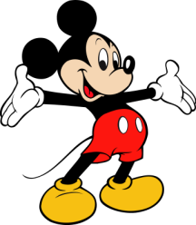
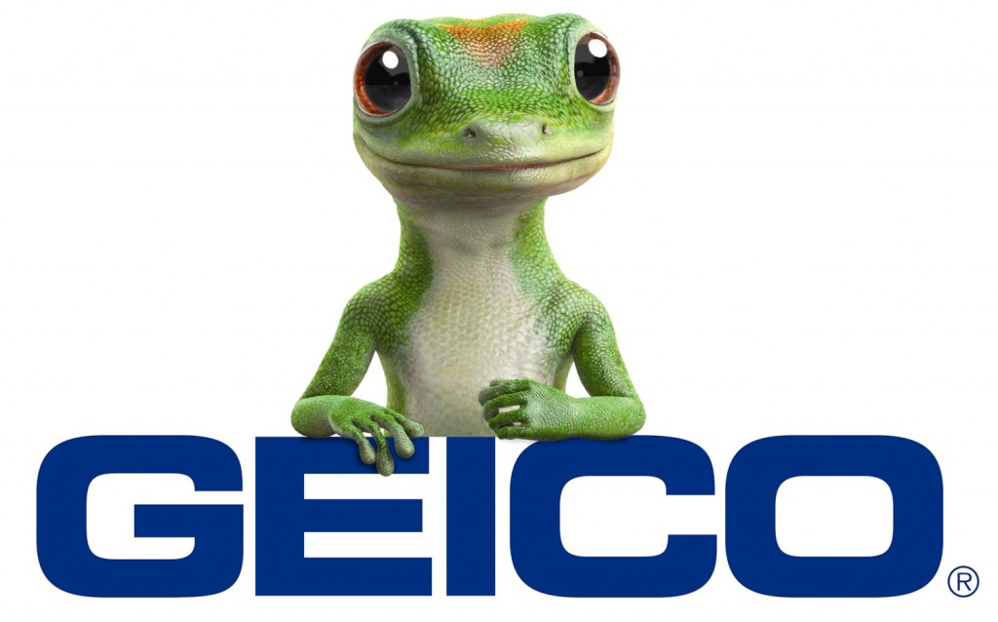
Trade Character
A Trade Character is a specific type of brand mark, one with human characteristics.
Example:

Slide 8

Manufacturer’s Brand
A Manufacturer's Brand is a National Brand; this is a brand in which the manufacturer has assumed all the responsibility of branding & makes all decisions regarding the use of the product

Slide 9


Private Brand
A Private Brand is A brand owned by an intermediary.
Most commonly called a Store Brand.

Slide 10
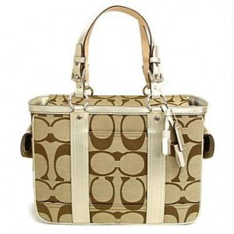
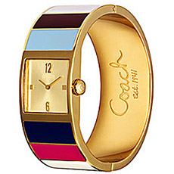
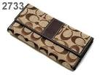
Family Brand
A Family Brand occurs when a brand uses the same brand for related products in a product line.

Slide 11
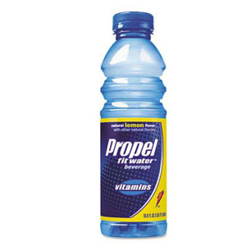
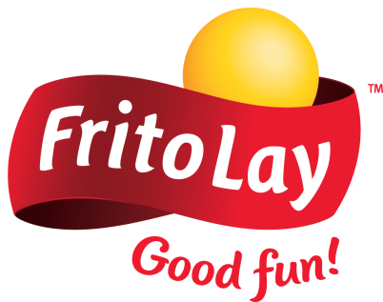

Individual Brand
An Individual Brand involves using different brands for products owned by one company. The company chooses not to list its Trade Name on the Product.

Slide 12
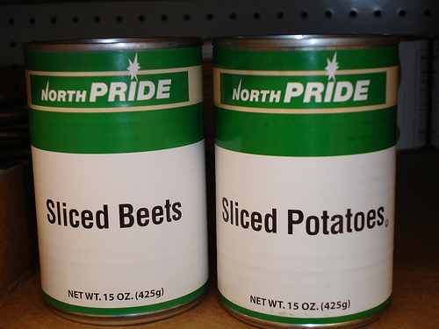
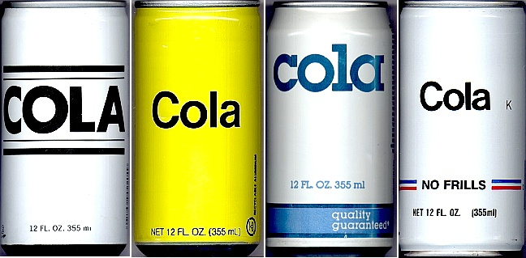
Generic Item(s)
A Generic Item are unbranded products that are plainly packaged, have lower or standard quality, are sold at lower prices than branded products, and receive little or no promotion.

Slide 13



Characteristics of a good brand name.
The name should:
  Describe the product’s benefits and uses
  Be easy to read, pronounce, and remember
  Create appealing images
  Be distinctive
  Be adaptable
  Be legally available for use
  Be appropriate for packaging and advertising

Slide 14
Brand Loyalty
Brand Loyalty is a customers allegiance to a particular brand.

Slide 15
Brand Recognition
Brand Recognition centers around the awareness a customer has for a brand.
Customer will have a certain level of understanding regarding the company they view.

Slide 16
Brand Preference
A Brand Preference occurs when a consumer has a preferred brand over other brands based on their positive experience with the brand.

Slide 17
Brand Insistence
A Brand Insistence occurs when a consumer will not accept an alternative brand. No substitute brand will work.
It is rare for a brand to reach this level but Apple & Coke are two brands that some consumers possess brand insistence for.

Slide 18
Trademark
A Trademark is a legal method for protecting brands from misuse externally.
Represented by the ® registration mark,
TM trademark ™,
or
SM service mark

Slide 19
Brand Position
A Brand Position is how a consumer views a brand in comparison to other competitive brands.
Companies try to standout from one another by utilizing
“Points of Difference”

Slide 20
Brand Extension
Brand Extension is when a company uses their brand name to create a new product line.
Example:
Jell-O goes from just selling jell-O to selling ice cream pops and mousse.

Slide 21
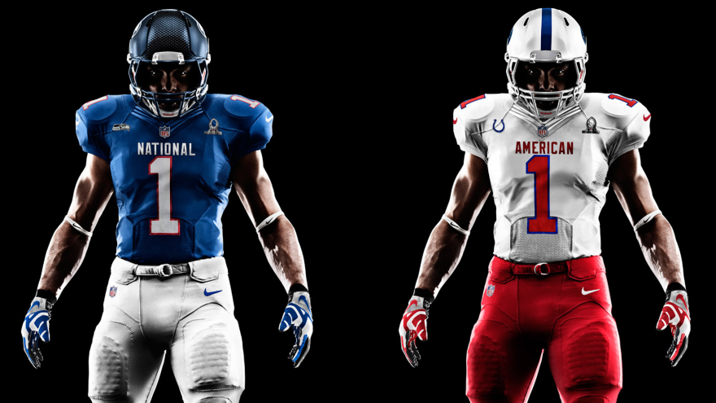
Brand Licensing
Brand Licensing allows one company to use another’s brand name, logo, or character for a fee.
Example:
Nike is a licensed dealer of the NFL.

Slide 22
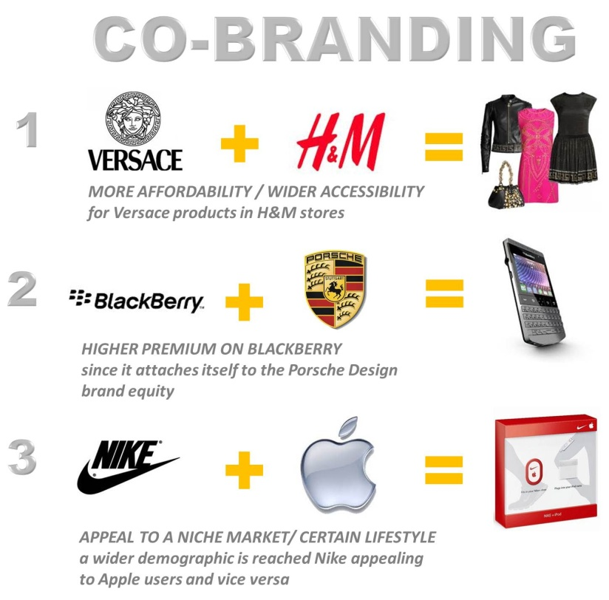
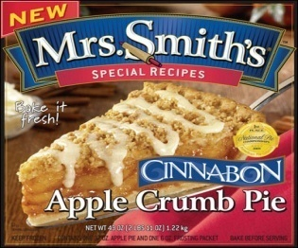
Co-Branding
Co-Branding occurs when companies join forces to increase recognition, customer loyalty, & sales for both brands.
Example:
Mrs. Smith’s & Cinnabon

