Slide 1
Branding
Strategic Marketing

Slide 2
09/25/13 Warm-up
Explain what the term branding means to you?
In your opinion……
Which celebrity has the strongest brand? Why?
What company has the strong brand? Why?

Slide 3
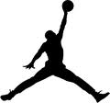
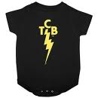
Individual Brands

Slide 4
Tiger
Woods
Jordan
Oprah
Lebron James
Roger Federer
Elvis

Slide 5
Yesterday’s Objective
Be able to define the terms Standards & Grades
Standard is the expectation
Grade is how the product performs in comparison to the standard set
Identify groups that create standards & grades
Government Agencies (FDA), Trade & Professional Organizations (AAA), & Businesses
Be able to explain why Standards & Grades are important
Maintains product consistency
Consumers know what to expect

Slide 6
FDA & Food Allowance
We trust brands
We have expectations, standards, and values that we expect from companies
Starbucks has bugs, snickers has rat hair, Canned Corn has larvae we start to question the quality & honesty of these companies

Slide 7
Write down the company you think of on back

Slide 8
Write down the company you think of on back
Colgate
Tide
Oreo
Heinz
Nike
Jif
iPhone
Red Bull
Marlboro
Tylenol
Campbell
Ben & Jerry’s
Gatorade

Slide 10
How Did Branding Start?
The earliest known form of “Branding” was a mark burned onto the skin with a hot iron, used to punish and identify criminals.
Used from the middle ages right through to the 15th and 16th centuries.

Slide 11
I OWN IT.. IT’S MINE!
Later it was a mark burned on to the hide of an animal, or an item of value to show who owned it, e.g. branding or burning of an owner’s mark on to the hide of cattle.
Branding in history was an attempt to use a logo, mark or symbol to :
Show ownership
Differentiate one from another
Demonstrate wealth
Project power/influence

Slide 12
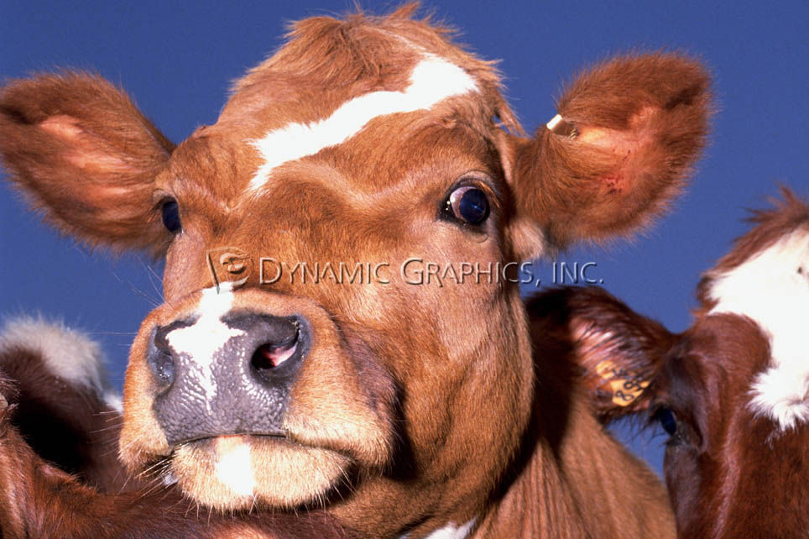
MINE!
It was simple, powerful, and effortlessly
distinguished one from another.

Slide 13
Branding
In today’s world, branding is the effort to create an individual identity for a product or service, so that is differentiated it from all its competitors.
Build a brand image
Create personality
Develop an emotional bond

Slide 14
Notes:
http://www.fastcompany.com/1555211/10-most-addictive-sounds-world

Slide 15
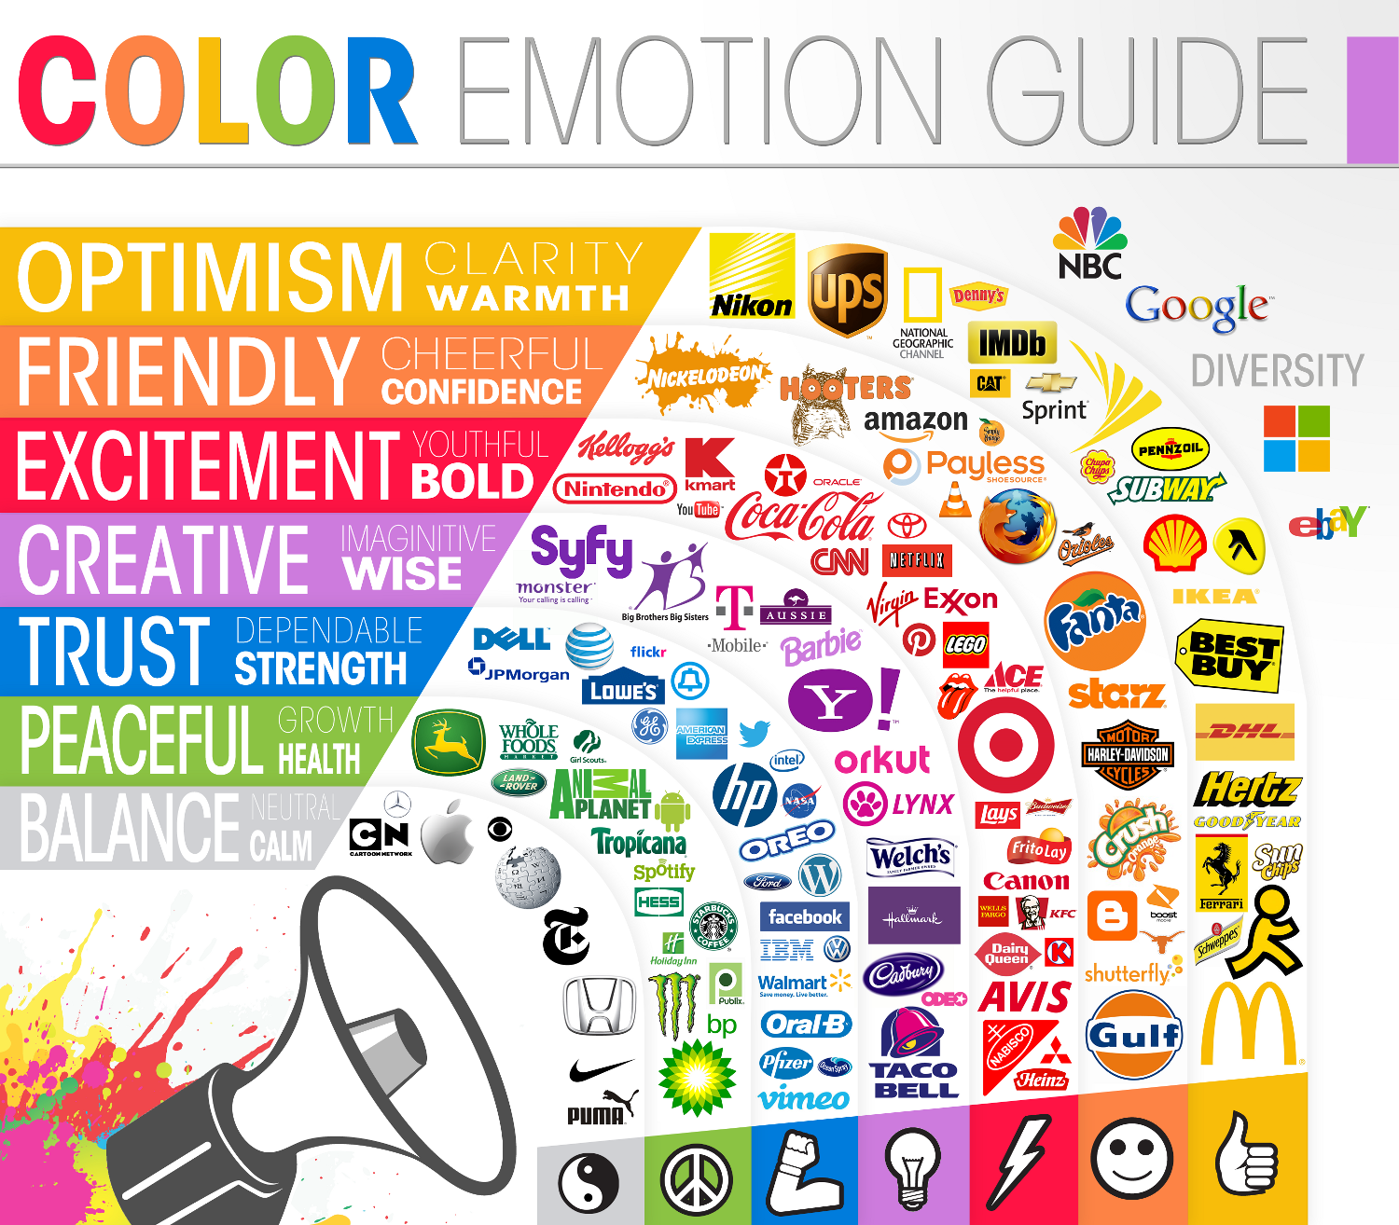

Slide 16
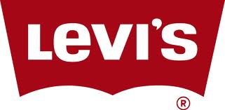
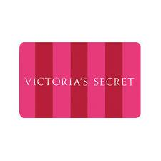
A brand identifies a seller’s product and differentiates them from their competitors
Characteristics Effective Brands
Easy to read, pronounce, and remember
Create appealing images
Distinctive
Adaptable
Appropriate packaging and advertising
Known benefits from products
Legally available

Slide 17
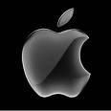
Branding
A brand name are the parts of the brand that can be spoken
Letters (PT Cruiser), Words (Barbie), & Numbers (WD-40)
The brand name is usually the product name
A brand mark are the elements of a brand that cannot be spoken
Logos

Slide 18
3 Main Purposes of Branding
Product Identification
Considered to be the most important purpose. Companies with strong Brand Equity & Global Brands have best success.
Brand equity refers to the value of company and brand names.
Higher the brand awareness, perceived quality, and brand loyalty means greater Brand Equity
Greater brand equity equals greater profits
Repeat Sales
*Satisfied customers will be loyal & Brand Loyalty is strong indicator of successful brand
New-Product Sales
Notes:
Brands are familiar and indicate quality

Slide 19
Brand Loyalty
 | Best Brand Loyalty | Worst Brand Loyalty
1. | Call of Duty Modern Warfare | Bank of America
2. | Sam Adams Light | Dell
3. | Samsung | JC Penny
4. | NBC Nightly News | American Eagle
5. | Costco | BlackBerry
Companies with Strong Reputations… Apple, Amazon, Walmart, TOMs, Target, FedEx, Red Bull, Crafstman, & Harley Davidson |  | Companies with bad reps… GM, Facebook, BP, Microsoft, Taco Bell, & KFC

Slide 20
Branding
Brand Loyalty is a consistent preference for one brand over all others.
Certain categories have higher %’s
Laundry Detergent, Shampoo, Car Companies
Strong brands carry on through generations
Family uses product, kid goes to college buys product, trend continues

Slide 21
BRAND EXPERIENCE
Consumers experience a Brand through its various touch points:
Product Quality | Counter Service
After-Sales Service | Sales & Marketing
Communications | Phone Enquiries
Retail / Merchandising | Distribution

Slide 22
WHAT IS A STRONG BRAND
A strong brand has measurable qualities which set it apart:
Positive Attributes
Tangible Benefits
Company values
Unique Personality Traits
Typical Users
Brand Equity

Slide 23
Global Branding
The term global brand has been used to refer to brands where at least 20% of the product is sold outside the country or region
Apple, Google, IBM, McDonalds, & Coca-Cola are top five global brands

Slide 24
Brand v. Product
Product | Brand
A product is something manufactured in a factory | A brand is something bought by a customer
A product can be copied by a competitor | A brand is unique
A product can become outdated quickly | A successful brand is timeless

Slide 29
A trademark is a word, name, symbol, device or a combination of these elements that is given legal protection by the federal government... to prevent other companies from using a similar element that might be confused with the trademarked one.

Slide 30
™ v. ®
Trademark ™
A way to alert the public to your claim. It is not registered with the US Patent and Trademark Office.
Registered Trademark®
Can only be used once the trademark registered with the US Patent and Trademark Office.
The US Patent and Trademark Office registers more than 350,000 trademarks per year
It is difficult to create a new brand name as so many names are already taken

Slide 31
Brand Name Trade Name
Trademark Trade Character

Slide 32
Trade Name
Brand Name
Trademark
Trade Character
Brand Name Trade Name
Trademark Trade Character

Slide 33
Assignment
Create a design of a product that includes:
1. Brand Name (include your first name)
2. Trade Name (include your last name)
3. Trademark (TM) or ®
4. Trade Character
5. A slogan that explains what your product is
The product can be anything you choose. The design can be created by hand or digitally. It should be in color and be an example of your best work.

Slide 34
Grading Sheet

Slide 35
Name Based on Information Given?

Slide 40
Social Media & Your Brand
Assignment #1
Tweet your brand (140 characters or less)
Explain your brand.
Cre

Slide 41
People Quitting Facebook
Assignment #1 | Assignment #2 | Assignment #3
Create a product First Name = Brand Name | Tweet your own brand (140 characters or less)
Trade Name = Last Name | Explain Meaning of tweet
Include Trademark | Create a logo that describes & defines you (visually)
Create a trade character representing your product | Explain how logo connects to your brand
Develop a slogan that explains how your product works

