Slide 1
10.2: International Pricing & Payments
International Marketing

Slide 2
10.1 Review
If you were gone last class you need to make up Unit 9.0 Test
30 Multiple Choice Questions & 3 Short Answer
Review of 10.1: Terms / Concepts You Should Know
Definition of Money
Characteristics of exchange rates(pegged / floating)
The law of supply & demand
What is demand?
Difference between hard & soft currency
Four major factors that influence exchange rates between countries
Transactional Demand, Economic Confidence, Money Supply, & Speculative Demand

Slide 3
10.1 Worksheet

Slide 4
10.1 Terms
Money = Medium of exchange used by a society
Hard Currency = Money that has earned the confidence of international markets
Soft Currency = Money that has not earned the confidence of international markets
Usually caused by political or economic instability. People don’t trust value.
Currency Exchange Rates:
Known as Foreign – Exchange Rates, Represents the ration of what one currency is worth compared to another, May fluctuate daily.
When exchange rates are set by supply & demand the currency is said to float (USD)
When exchange rates just have a set rate compared to another currency it is said to be pegged (Soft currencies to a country they frequently do business with)

Slide 5
Law of Supply & Demand
Demand reflects a consumers willingness to purchase a product at a given price
Demand that shifts to the right increases overall demand
Demand that shifts to the left decreases overall demand
Supply reflects producers willingness to offer a product at a given price.
●
●
●
●
●
●
1
1
2
3
5
7
10
1
2
3
4
6
8
11
0
0
1
1
2
3
4
●
●
●
●
●
●
●
●
●
●
●
●
●
●
●
1 2 3 4 5 6 7 8 9 10 11

Slide 6
10.1 Worksheet Backside

Slide 7
Characteristics of 4 Major Factors Influencing Exchange Rates
Transactional Demand: The amount of economic activity in a country creates transactions—the more economic activity, the more transactions, therefore greater demand for currency
Economic Confidence: If international investors lose confidence in an economy, they may try to sell the currency holdings resulting in to increased supply of the currency and therefore decreased value of the currency.
Money Supply: Interest rates effect the bank lending activities. When banks drop interest rates, more money is borrowed resulting into increased economic activities and supply of money. However too low of a interest rate causes inflation and that makes the currency less desirable by foreign investors.
Speculative Demand: Some international investors use forward events(ex: elections) to speculate on future currency rates. Currency is bought & sold based on future exchange rates.

Slide 8
10.2: International Pricing & Payments
p. 238 -242

Slide 9
Key Terms / Concepts to Know
Price (p.238)
Setting Prices (p. 239)
Price Floor
Price Ceiling
Pricing Strategies (p.239)
Penetration Pricing
Skim Pricing
Market Pricing
Prestige Pricing
Factors that affect International Pricing (p.241)
Elasticity of Demand, Government Regulation / Value Added Tax Rates, & Stability of tax rates
International Payments (p. 241)
Letter of Credit
Revocable v. Irrevocable
Cash in Advance Strategy

Slide 10
Global Pricing Strategies
Price
The amount of money, goods, or services needed to acquire a given quantity of other goods or services
Price must be justified against benefits customer will receive
Money is most common method of payment for price
Bartering is also an acceptable method of payment
Soft currency / communist countries rely on barter where goods & services are used in place of money
Price is a strategic tool that can be changed easily and rapidly to manage inventory, increase sales, or to compete against other companies

Slide 11
Strategies to Set a Price:
Price Floor
the lowest price a company can charge and still cover costs
If price is too low, may be accused of dumping
Price Ceiling
the maximum price that can be charged in a market.
Usually set by the value customers see in a product & the price the competition charges.

Slide 12
Pricing Strategies
Penetration Pricing:
Sets a low price compared to competitors.
Helps a company to capture market share.
Often used for short term till market goals are met.
Skim Pricing:
a temporary strategy where a company sets a high price for a brief time.
Ideal for new, innovative products.
Market Pricing
pricing that can be justified by the competitive advantages of a product relative to products already in the marketplace.
Prices are set higher or lower based on competitive advantages.
Prestige Pricing
a company sets a high price throughout the life of a product to signal quality.

Slide 13
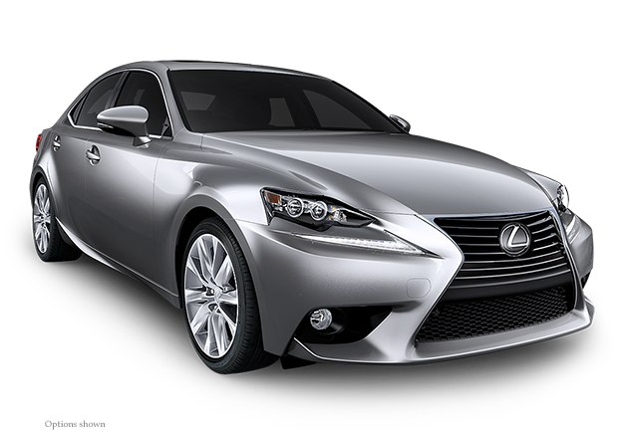
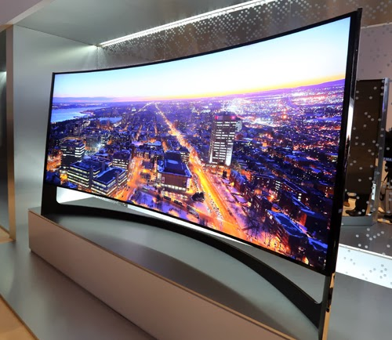
Examples of Pricing Strategies

Slide 14
Difference between Standardized Global Price & Standardized Global Strategy
Standardized Global Price would be one price, for one product regardless of where its sold.
Example: iTunes is consistently sold for the same price in every country.
Standardized Global Price Strategy is implementing the same pricing strategy regardless of where product is sold.
Example
Walmart is always going to use a low price strategy but their prices vary based on location.

Slide 15
Factors Effecting International Pricing
1.Elasticity of demand: the relationship between changes in a product’s price and the demand for that product
Inelastic products, that offer few substitutes, may have higher prices
Brand image, patent or copyright laws lead to this type of product
Elastic products, that offer several good substitutes, will have lower prices.
2. Government regulations (tariffs or value added taxes).
3. Stability of exchange rates.
4. Other external factors such as political stability
5. Export-related costs
Cost of shipping, product modification, taxes, etc..

Slide 16
International Payments
A secure way of making international payments
must be agreed upon by the buyer and the seller.
Forms of International Payment:
Cash in Advance: Buyer pays in cash in advance of the product being received.
Not widely used except for first time transactions
Most favorable term for exporters
Buyer incurs most risk
Letter of Credit (LC) is used to minimize risk
Financial document issued by a bank with a promise to pay
Irrevocable, confirmed, revolving
Risk is shifted to seller

Slide 17
Letters of Credit Example
Tommy’s T-shirt Store based out of Houston is importing t-shirts from China
Step #1: Tommy’s T-shirts contacts their bank and requests a letter of credit is created
Step #2: Tommy’s bank sends the letter to its Exporters bank in China
Step #3: Chinese bank will notify exporter that letter has been received
Step #4: The exporter in China approves the terms of the letter
Step #5: The exporter will ship the product to Tommy’s T-Shirts
Step #6: The exporter then sends shipping documents to Tommy’s bank
Step #7: Once Tommy’s bank is satisfied that contract conditions have been met, it sends payment to exporter’s bank in China.

Slide 18
Letters of Credit
Letters of credit can be revocable or irrevocable
Revocable letters of credit can be revoked or modified
Not a common practice
Allows for changes in documentation by the issuing bank, without notification, until sales process is completed
Irrevocable letters of credit cannot be revoked or modified without the consent of the importers bank, the exporters bank, & the exporter.
Most common type of letter of credit used

Slide 19
10.2 Assignment
Assignment #1:
Create a chart that depicts all six pricing strategies
Your chart will have 7 rows & 4 columns
Each row needs to address the following:
Pricing Strategy | Define in your own words | A product for which you will use this strategy | Explain why the product & pricing strategy are a good fit
Price Floor
Price Ceiling
Penetration Pricing
Skim Pricing
Market Pricing
Penetration Pricing

Slide 20
Assignment #2: Letter of Credit
Display your understanding of what a letter of credit means by completing the Letter of Credit Template in Edmodo:
Create a fictional American Company that is going to import a product
Draft a Letter of Credit from any American lending institute you wish to use
Example: Brite Lites Teddy Bears & Wells Fargo
Your letter will be sent to a Lending Institute in a foreign country that represents the company you are importing from
Include in your letter all of the requirements given in Edmodo

Slide 21
To: American Company Name / From: Foreign Exporter Name
#1 (Determine whether letter is revocable or irrevocable)
#3: Who is the beneficiary (exporter name & address) of letter
#4: When will the letter of credit be paid
#6 What method of payment will be used to pay for shipment
#7: Will the amount owed be set a ceiling price or an estimated price
#8: What paperwork will you require or not require in order for payment to be made
#9: Specify quantity & description of item being shipped
#10: Method of shipment being used
(http://www.sourcingchinaproducts.com/blog/international-trade/international-trade-knowledge/13-commonly-used-international-trade-termsciffobcfr/)
#11 Bill of Lading is marked Freight Collect or Freight Prepared
#13 Are Partial Shipments allowed
#14: Latest day you will accept shipment of this product
#15 Latest date you will accept all required paperwork regarding this shipment
#16: Expiration date of the letter of credit
#17 Who pays banking fees that occur outside the United States
#18 Will the letter of credit be transferable
#19 Any other special instructions.

Slide 22
Assignment #3: Pricing strategy Applied to a specific product
Set a price for a new product.
Identify a new product you think could be successful on the market and set an introductory price for it. Use the following questions to structure your written analysis.
What is the product?
Who is the target market?
What are its benefits to the target market?
At what price will it be introduced?
What pricing strategy are you using?
What objectives will be accomplished by using this strategy?
Why is the product worth this price?
Do you intend to raise or lower the price after the introductory period? Why?
Illustration of the newly priced product.
Is this product a product that has elastic or inelastic demand? Justify answer.

Slide 23
Complete Only 1 of the 2 Pricing Strategies
Develop a long-term pricing strategy for an existing product. Choose an existing product and decide how you will change the price of the product during its life cycle. Use the following questions to structure your written analysis.
What is the product?
Who is the target market?
How is the product differentiated/positioned?
At what stage in the life cycle is the product?
What is its current price?
What price do its competitors charge?
What prices will you charge in the remaining stages of the product life cycle?
What objectives will be accomplished this way? How?
Illustration of the newly priced product.
Is this product a product that has elastic or inelastic demand? Justify answer.

